Slide 1
Encouraging Vaccine Uptake
Notes:
Now that we’ve learned about the nature and causes of vaccine hesitancy, and the role misinformation plays, we can move on to discuss strategies to encourage vaccine uptake! Although some people may be hesitant about vaccinations, there are many strategies we can use to encourage vaccine uptake. However, these strategies may not be as straightforward as you envision.

Slide 2
Encouraging vaccine uptake
Correcting misperceptions (CDC info that MMR vaccine does not cause autism)
Present info about disease risks (CDC info about disease risks)
Dramatic narrative (“106 degrees: A true story” - An infant who almost died of measles)
Visuals of vaccine preventable diseases
Nyhan, B., Reifler, J., Richey, S., & Freed, G. L. (2014). Effective messages in vaccine promotion: a randomized trial. Pediatrics, 133(4), e835-e842.
Notes:
Encouraging vaccination can be challenging. In the study presented here, parents were randomized to view one of four messages promoting the MMR vaccine, or to a control group. The first message clearly corrected the misperception that the MMR vaccine causes autism. The second message presented information about the risks of the diseases prevented by the MMR vaccine. The third message featured a dramatic narrative from a parent whose infant almost died from measles. And the fourth message visually demonstrated the effects of these diseases. Now, think for a moment. What do you think the effect of each message was?

Slide 3
Encouraging vaccine uptake
Decreased intent to vaccinate among those initially most hesitant; No change among everyone else
Correcting misperceptions (CDC info that MMR vaccine does not cause autism)
Present info about disease risks (CDC info about disease risks)
Dramatic narrative (“106 degrees: A true story” - An infant who almost died of measles)
Visuals of vaccine preventable diseases
No change
Nyhan, B., Reifler, J., Richey, S., & Freed, G. L. (2014). Effective messages in vaccine promotion: a randomized trial. Pediatrics, 133(4), e835-e842.
Notes:
Well, this study found that none of the messages succeeded in encouraging parents to vaccinate their children. And in fact, the message correcting misperceptions about the vaccine actually decreased intent to vaccinate one’s child among those who were initially most hesitant about vaccines. But - all hope is not lost. What this study tells us about vaccine communication is that it is nuanced and must be done with care. Fortunately, there is plenty of research documenting effective techniques.

Slide 4
Know your audience
Develop targeted messages based on your audience’s characteristics
Baseline level of hesitancy
Specific concerns about the vaccine
Other factors such as culture, values, etc.
For example:
How enthusiastic is your audience about the Covid-19 vaccine?
Are there specific things that worry them? (E.g., vaccine development timeline, potential side effects)
What cultural factors are relevant to your population? What is important to them? (E.g., freedom, liberty, community, family)
MacDonald NE, Butler R, Dubé E. Addressing barriers to vaccine acceptance: an overview. Human vaccines & immunotherapeutics. 2018 Jan 2;14(1):218-24.
Notes:
The first takeaway is something that stands for any type of communication - you must know your audience. Whether you are communicating one-on-one with a patient, client, or friend or family member, or to a large audience, it is critical to know who you are communicating with. This allows you to develop a specific message based on your audience’s characteristics. Some things that would be useful to know are what the audience’s baseline level of hesitancy is - someone who is mostly enthusiastic about the vaccine might just need that enthusiasm reinforced, while someone who is more hesitancy might need their concerns addressed. You, of course, would want to know what these specific concerns were - does the vaccine development timeline worry them? are they fearful of potential side effects? Concerned the vaccine might not be effective? Worried about the safety profile? Understanding these concerns allows you to specifically address them. And, of course, it is important to be mindful of other factors such as culture, values, and so on. For example, some people may think of a Covid-19 vaccine as a way to protect their family and their community, while others might think of the vaccine in terms of freedom or liberty - so, in that case, we might want to emphasize how the vaccine can enable one to have the freedom to live life free from worry about Covid-19.

Slide 5
Trust is important
Information should come from trusted sources
Think outside the box and create partnerships with trusted individuals or organizations within a community
For example:
Federal agencies or employees: CDC, FDA, Dr. Fauci
State and local departments of public health
Community organizations and non-profits
Doctors on social media, others who have stood out as Covid-19 communicators
MacDonald NE, Butler R, Dubé E. Addressing barriers to vaccine acceptance: an overview. Human vaccines & immunotherapeutics. 2018 Jan 2;14(1):218-24.
Notes:
Next, the issue of trust is of the utmost important. People are more amenable to information when it is coming from a trusted source. So, make sure you are earning the trust of your audience. You might also think outside the box and identify other sources who are trusted within the community you are working with. This could be community leaders, local businesses, or even celebrities or social media influencers - whoever your audience trusts to get health information from.

Slide 6
Make vaccination the default
“You’re due for your vaccine” vs. “Would you like the vaccine today?”
Omer SB, Amin AB, Limaye RJ. Communicating about vaccines in a fact-resistant world. Jama Pediatrics. 2017 Oct 1;171(10):929-30.; Image via Self x American Academy of Pediatrics Immunization Image Gallery (https://www.aap.org/en-us/Pages/immunizations-image-gallery.aspx)
Notes:
Next, when communicating about the vaccine, present the vaccine as the default. One way of doing this, for example, would be to tell a patient, “You’re due for your vaccine” when they come into the doctor’s office.

Slide 7
Focus on the disease
Severity of the disease
Likelihood of hospitalization
Mortality rates
Long-term effects
Susceptibility to the disease
Likelihood of contracting Covid-19
Omer SB, Amin AB, Limaye RJ. Communicating about vaccines in a fact-resistant world. Jama Pediatrics. 2017 Oct 1;171(10):929-30.
Notes:
Next, research has shown that focusing on the disease the vaccine intends to prevent is a useful strategy. This consists of two components: focusing on the severity of the disease, and the susceptibility of the disease. So, in the case of Covid-19, messaging should clearly describe the severe effects of the disease - for example, likelihood of hospitalization, mortality rates, long-term effects of the disease. We can alsodescribe prevalence and/or transmission data to illustrate one’s susceptibility to the disease. This strategy is often preferred to communication that bluntly addresses myths about the vaccine - but, it may also be necessary to combat vaccine misinformation.

Slide 8
Myth correction must be done carefully
Clearly indicate the misinformation is FALSE before you introduce it
Focus on key points
Provide the accurate explanation
Omer SB, Amin AB, Limaye RJ. Communicating about vaccines in a fact-resistant world. Jama Pediatrics. 2017 Oct 1;171(10):929-30.
Notes:
In this case, if you do seek to combate myths and misinformation about the vaccine, do so with care. First, before you present any misinformation so that you can debunk it, first clearly state that the misinformation is false, before you introduce it. Then, when you do debunk the myth, focus on the key points - don’t get mired in minute details that are unlikely to matter to most people. Additionally, provide an alternate explanation. We shouldn’t simply retract misinformation, or state it is false - we must provide the accurate causal explanation.

Slide 9
Using causal chain correctives to correct myths
Fill in the gap left by ‘removal’ of the myth!
Don’t simply retract information, provide the accurate causal explanation!
Corrective must:
Be plausible
Fill in the causal gap
Explain why the misinformation was incorrect
Explaining the motive for the misinformation can be especially helpful
Simple correction/explanation may be more effective
If too complex, people may continue to rely on incorrect yet simple misinformation
Lewandowsky S, Ecker UK, Seifert CM, Schwarz N, Cook J. Misinformation and its correction: Continued influence and successful debiasing. Psychological science in the public interest. 2012 Dec;13(3):106-31.
Notes:
A “causal chain corrective” is a useful technique for providing an alternate explanation. When an individual believes a myth, and we then attempt to debunk that myth, we leave behind a ‘gap’ when the myth is removed. For example, if an individual believes that vaccines cause autism, and our messaging only says “No, vaccines do not cause autism,” that individual’s mental model regarding vaccines and autism is left with a gap. Why does autism appear so close to the time of vaccination? Why is it implausible for vaccines to cause autism? So, we need to fill that gap in! This is known as a causal chain corrective statement - in which the myth correction also provides a causal explanation to close the gap left by the correction of the misinformation. When we do this, we need to make sure our explanation is plausible and that it does fill in that gap. It can also be useful to explain why the misinformation was incorrect in the first place, and perhaps even explain the motive for the misinformation. For instance, perhaps the myth was started by someone trying to sell an alternate unproven treatment! Finally, again be mindful that a simple correction and explanation may be more effective than a highly complex correction. If our corrections get lost in the weeds and become too complex, people may continue to rely on incorrect yet simple misinformation.

Slide 10
Using causal chain correctives to correct myths
For example:
→ Explain that some people may believe autism is caused by vaccines because autism happens to be diagnosed during an age at which children receive several vaccines.
→ Explain motives of people spreading this misinformation.
→ Explain how we know that vaccines do not cause autism.
Lewandowsky S, Ecker UK, Seifert CM, Schwarz N, Cook J. Misinformation and its correction: Continued influence and successful debiasing. Psychological science in the public interest. 2012 Dec;13(3):106-31.; Image via Self x American Academy of Pediatrics Immunization Image Gallery (https://www.aap.org/en-us/Pages/immunizations-image-gallery.aspx)
Notes:
What might this look like? Well, we could start by explaining why some people believe autism is caused by vaccines - for example, noting that autism happens to be diagnosed during an age at which children receive several vaccines. Then, we can explain the motives of people spreading this misinformation - for example, financial interest. We can then fill in the causal gap by clearly explaining how we know that vaccines do not cause autism, and any addirional information we know about what the causes of autism might be.

Slide 11
Self-affirmation
General connection to or reminder of personal values, personal strengths can increase acceptance of corrective information
Steele, C. M. (1988). The psychology of self-affirmation: Sustaining the integrity of the self. In L.Berkowitz (Ed.), Advances in experimental social psychology (pp. 261–302). New York: Academic Press.
Zhao, X., & Nan, X. (2010). Influence of self-affirmation on responses to gain-versus loss-framed antismoking messages. Human Communication Research, 36(4), 493-511.
Notes:
It is also important to note that when we correct misinformation, or otherwise present information that does not correspond with an individual’s values, worldview, and so forth, we may encounter resistance. It doesn’t feel good to be told you are wrong! Self-affirmation theory tells us that when we present this type of information, it can be useful to ensure people feel valued and validated. Making a general connection to, or reminding people of their personal values and personal strengths can provide a little boost and increase acceptance of corrective information.

Slide 12
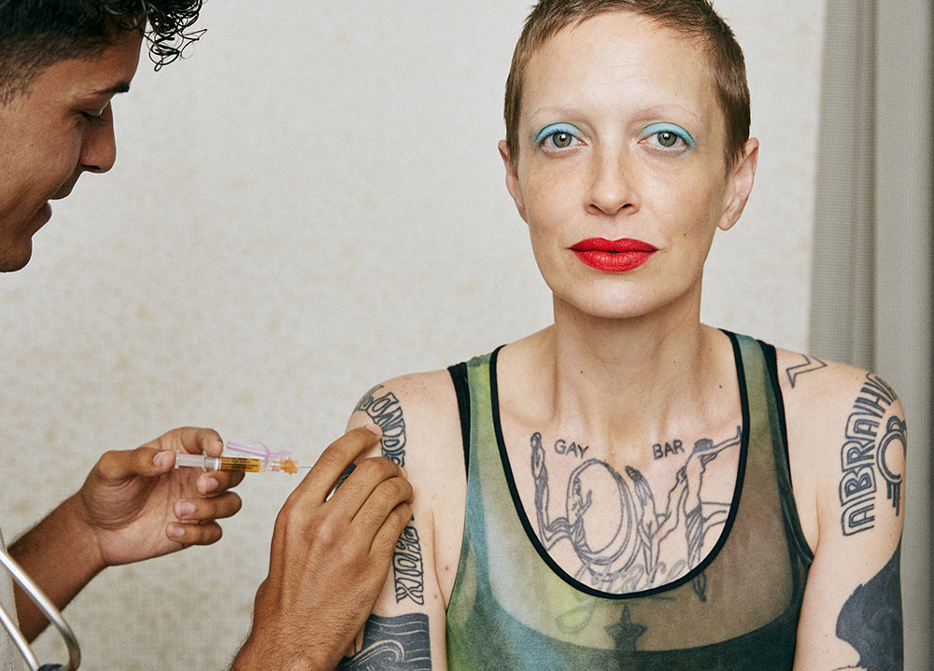
Inoculation against misinformation
→ Forewarn the audience about the misinformation they are likely to encounter
→ Refute the misinformation
→ Audience is now prepared with resources to refute the misinformation themselves, when they encounter it
→ A ‘booster shot’ may be needed
McGuire WJ, Papageorgis D. The relative efficacy of various types of prior belief-defense in producing immunity against persuasion. Public Opinion Quarterly. 1961; 26, 24–34.; Maertens et al., Long-Term Effectiveness of Inoculation Against Misinformation: Three Longitudinal Experiments; Cook, J., Lewandowsky, S., & Ecker, U. K. (2017). Neutralizing misinformation through inoculation: Exposing misleading argumentation techniques reduces their influence. PloS one, 12(5), e0175799.; Image via Self x American Academy of Pediatrics Immunization Image Gallery (https://www.aap.org/en-us/Pages/immunizations-image-gallery.aspx)
Notes:
This final communication strategy is a useful supplement to the approaches just discussed and, in fact, is rooted in the inoculation metaphor! Much the same way that a vaccine can train the body’s defenses to fight a disease by introducing a weakened, attenuated, or altered form of the disease that the body can easily handle, inoculation against misinformation involves warning people against misinformation so they can build their defenses against it. In this approach, we first forewarn individuals about the misinformation they are likely to encounter. We then refute the misinformation, so the audience is now prepared with the resources they need to refute the misinformation themselves when they encounter it. Thus, this boosts the audience’s ‘immunity’ so to speak, against misinformation! One caveat with this approach - the effects of the initial warning and refutation may wear off, so we want to make sure we continue to warn and refute - much like a booster shot.

Slide 13
Conclusions
Vaccine hesitancy is nothing new
There is a wide spectrum of attitudes about vaccines
Misinformation about vaccines circulates and can influence opinions
There are multiple strategies for effective vaccine communication!
Notes:
To conclude, we need to remember that vaccine hesitancy is nothing new, and that there is a wide spectrum of attitudes about vaccines. Most people simply want to make sure they are making the best decision for themselves and their families. Misinformation about vaccines certainly does circulate, and can influence vaccine hesitancy - but there are many strategies for effective vaccine communication. Remember, researchers have been studying how to best promote vaccine uptake for years, and have developed multiple tools that we can use to communicate about the Covid-19 vaccine.

