Slide 1
Vaccine Hesitancy
Notes:
As you know by now, vaccines are incredibly important ways to control and prevent the spread of disease. Thus, we want to make sure they are available and as widely adopted as possible. This module explores the topography of vaccine hesitancy - or why people are unsure about vaccination.

Slide 2
Vaccine Hesitancy
“Vaccine hesitancy refers to delay in acceptance or refusal of vaccines despite availability of vaccine services.”[1]
In 2019, 5.6% of US parents were very hesitant and 13.8% somewhat hesitant about childhood shots. [2]
1. Report of the SAGE Working Group on Vaccine Hesitancy. (2014). Available at: https://www.who.int/immunization/sage/meetings/2014/october/1_Report_WORKING_GROUP_vaccine_hesitancy_final.pdf; 2. Santibanez, T. A., Nguyen, K. H., Greby, S. M., Fisher, A., Scanlon, P., Bhatt, A., ... & Singleton, J. A. (2020). Parental vaccine hesitancy and childhood influenza vaccination. Pediatrics, 146(6). Available at: https://pediatrics.aappublications.org/content/early/2020/11/05/peds.2020-007609
Notes:
Although most people get vaccines recommended for themselves or their children, some feel unsure about this. This is known as vaccine hesitancy. Vaccine hesitancy refers to delay in acceptance or refusal of vaccines, despite availability of vaccine services. In other words, even though an individual may have total access to a vaccine, they may still avoid getting it. To give you a sense of the breadth of vaccine hesitancy in the United States, 5.6% of parents in the US reported being very hesitant about childhood shots, and 13.8% reported being somewhat hesitant about childhood shots.

Slide 3
Vaccine Hesitancy
Report of the SAGE Working Group on Vaccine Hesitancy. (2014). Available at: https://www.who.int/immunization/sage/meetings/2014/october/1_Report_WORKING_GROUP_vaccine_hesitancy_final.pdf
Notes:
Vaccine hesitancy can be thought of as a spectrum, or continuum. On the one end are folks who get all of the recommended vaccines on the recommended timeline and have no uncertainties about this. Then there are others who get all of the recommended vaccines on the recommended timeline, but who may harbor a bit of uncertainty. Then there are individuals who may get some reccommended vaccines, but not others. Or they may delay receiving some vaccines, but eventually get them. Then on the other end are folks who refuse all vaccines. As noted, there are not many individuals in the US who refuse all vaccines entirely.

Slide 4
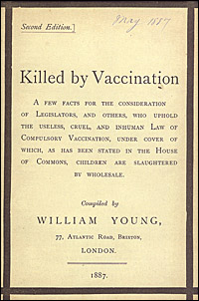
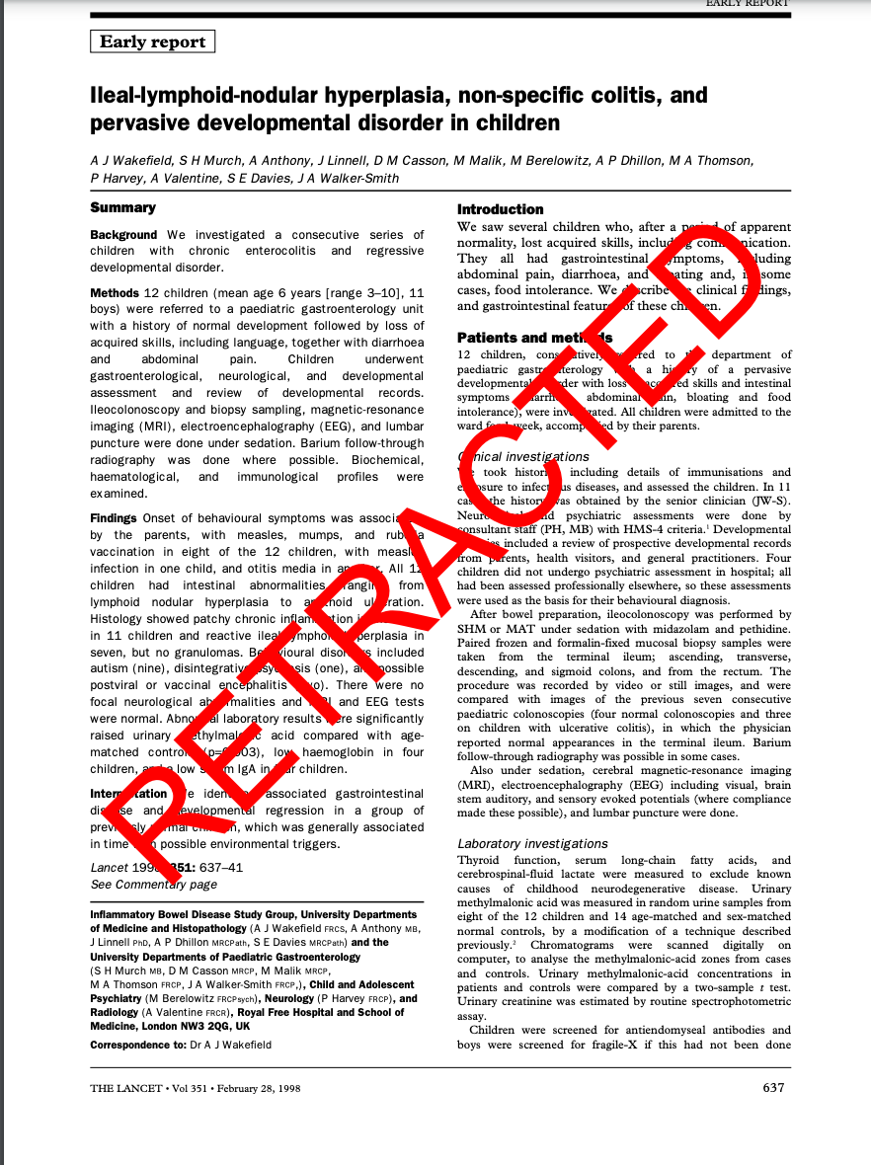
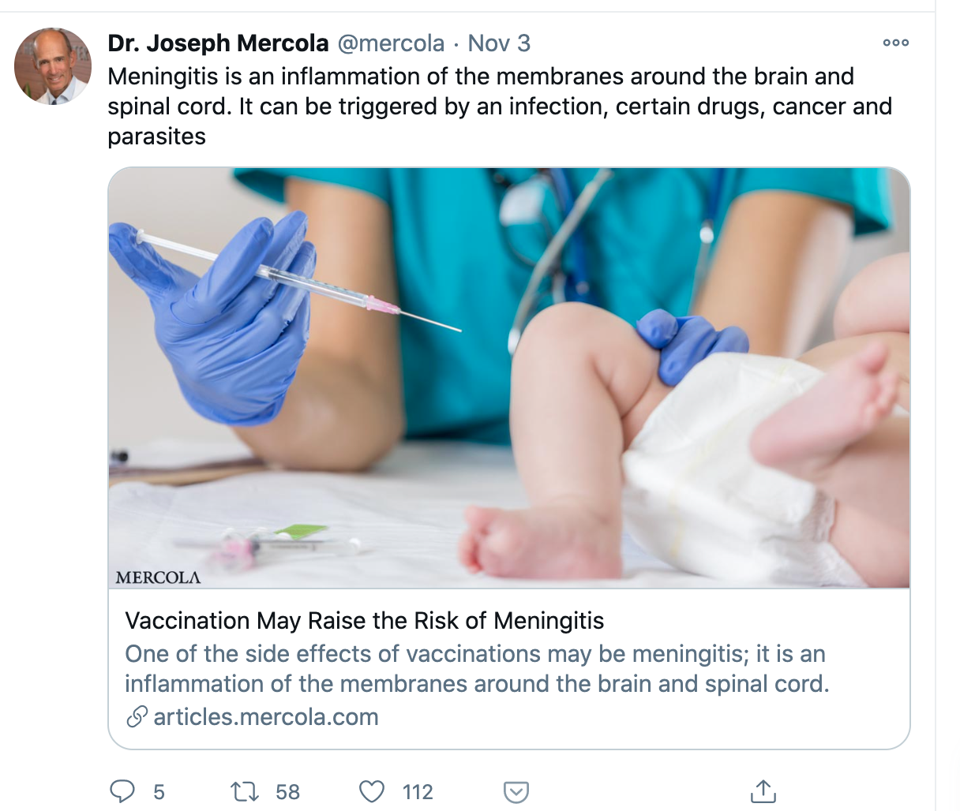
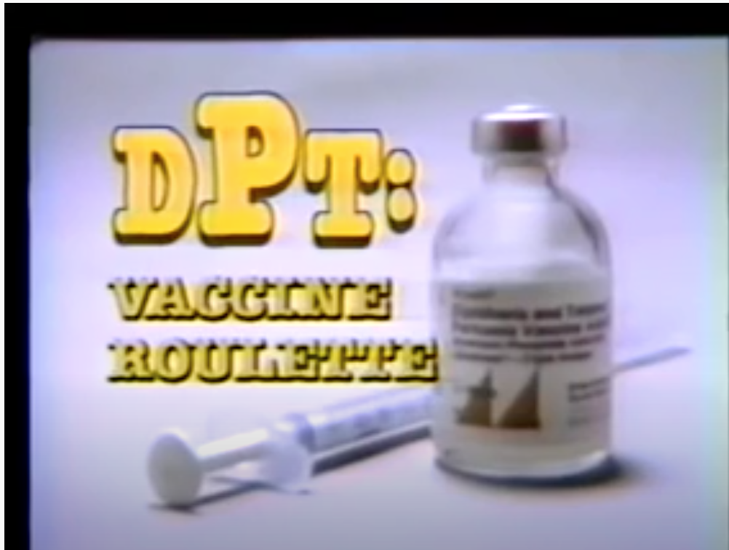
History of Vaccine Hesitancy
Information on slide from: Dube, E., Vivion, M., & MacDonald, N. E. (2015). Vaccine hesitancy, vaccine refusal and the anti-vaccine movement: influence, impact and implications. Expert review of vaccines, 14(1), 99-117.; Killed by Vaccination image from: https://www.nlm.nih.gov/exhibition/smallpox/sp_resistance.html; Screenshot of Wakefield, A. J., Murch, S. H., Anthony, A., Linnell, J., Casson, D. M., Malik, M., ... & Valentine, A. (1998). RETRACTED: Ileal-lymphoid-nodular hyperplasia, non-specific colitis, and pervasive developmental disorder in children.; DPT image from WRC-TV documentary, DPT: Vaccine Roullette: https://www.youtube.com/watch?v=0w3P7_H_ods
Notes:
Vaccine hesitancy is nothing new. It dates back to the late 1700’s when the smallpox vaccine was developed. Even though this disease had a high death rate, there was still considerable backlash towards the vaccine. As you can see in the image on the left, there was particular resistance to the notion of compulsory vaccination. Scholars trace the advent of vaccine hesitancy in the US to a documentary released in 1982 titled DPT: Vaccine Roulette, which claimed that the DPT vaccine caused brain damage. In 1998, Andrew Wakefield published a now-retracted paper claiming an association between the MMR vaccine and autism, prompting another wave of renewed vaccine hesitancy. And today, of course, the current media landscape allows anti-vaccine sentiment to proliferate online.

Slide 5
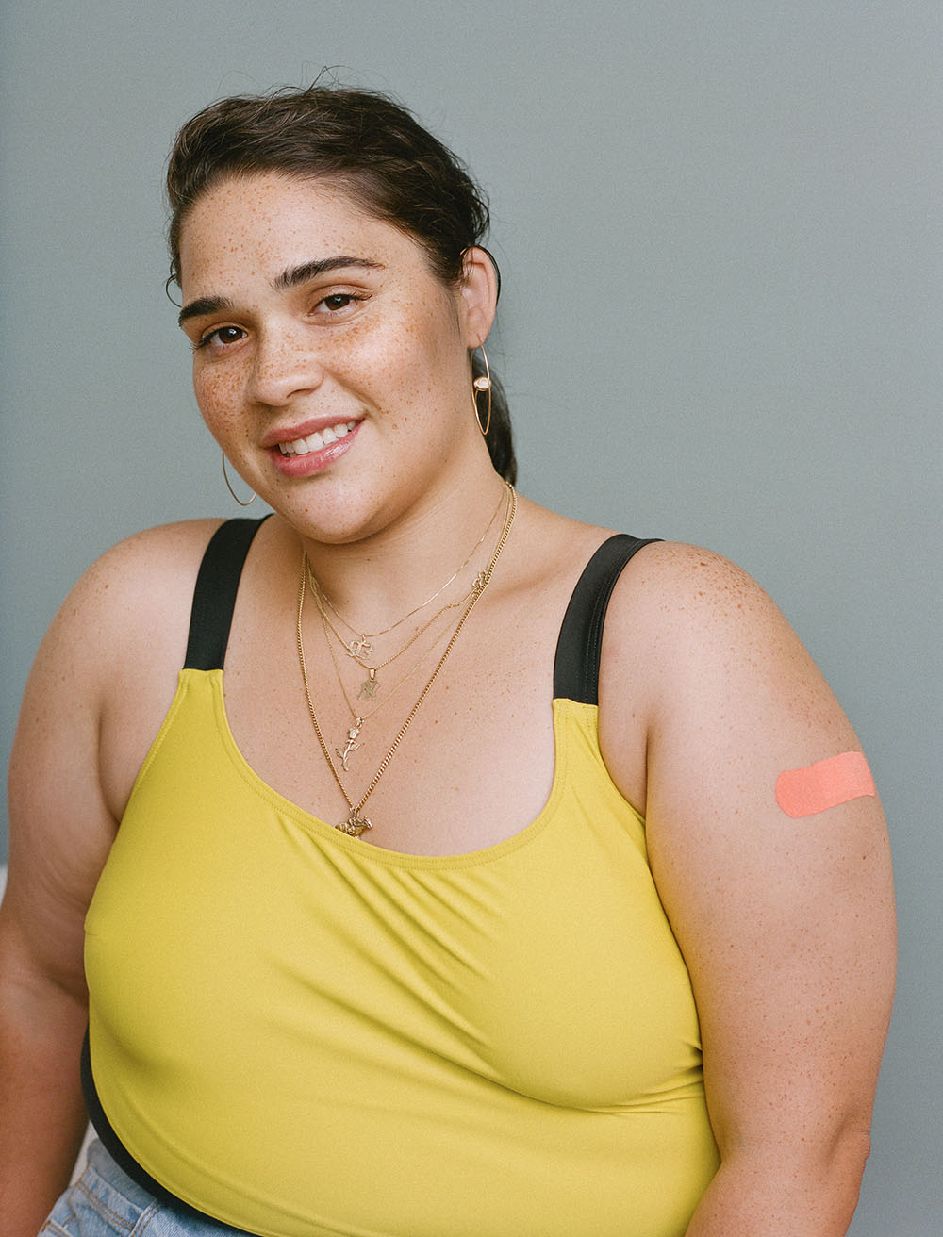
Reasons for vaccine hesitancy
Confidence
Complacency
Convenience
Report of the SAGE Working Group on Vaccine Hesitancy. (2014). Available at: https://www.who.int/immunization/sage/meetings/2014/october/1_Report_WORKING_GROUP_vaccine_hesitancy_final.pdf; Image via Self x American Academy of Pediatrics Immunization Image Gallery (https://www.aap.org/en-us/Pages/immunizations-image-gallery.aspx)
Notes:
Since we know that vaccines are safe and effective disease prevention tools, why would an individual not want to receive one? The SAGE Working Group on Vaccine Hesitancy groups people’s reasons for vaccine hesitancy into 3 categories: Confidence, Complacency and Convenience. We’ll go through these one by one on the following slides.

Slide 6
Reasons for vaccine hesitancy: Confidence
Perceived safety of the vaccine
Fears that the vaccine will cause death or disease such as autism, SIDS, auto-immune disorders
Perceived effectiveness of the vaccine
Beliefs that the vaccine will do little to protect one from the disease
In the case of a Covid-19 vaccine, individuals may have concerns about the vaccine development timeline, politicization of the vaccine
Lack of confidence may also be rooted in structural racism and systemic exploitation by the medical system
Report of the SAGE Working Group on Vaccine Hesitancy. (2014). Available at: https://www.who.int/immunization/sage/meetings/2014/october/1_Report_WORKING_GROUP_vaccine_hesitancy_final.pdf; ; Siddiqui, M., Salmon, D. A., & Omer, S. B. (2013). Epidemiology of vaccine hesitancy in the United States. Human vaccines & immunotherapeutics, 9(12), 2643-2648.. Available at: https://www.tandfonline.com/doi/full/10.4161/hv.27243
Notes:
First, people may be hesitant about vaccines due to low vaccine confidence. This manifests in two ways. First, people may not believe that a vaccine is safe. In particular, there may be concerns that a vaccine will cause death, or diseases such as autism, SIDS and auto-immune disorders. Second, people may believe that a vaccine is ineffective. In other words, they may believe that the vaccine will do little to protect them against a disease. Both of these factors contribute to vaccine hesitancy.

Slide 7
Reasons for vaccine hesitancy: Complacency
Perceptions that risk of vaccine-preventable disease is low
Likelihood of getting the disease is low
Severity of the disease is low
In the case of Covid-19, individuals may not perceive themselves to be at risk for the disease, or may think that if they do get it, they will have a mild case
Report of the SAGE Working Group on Vaccine Hesitancy. (2014). Available at: https://www.who.int/immunization/sage/meetings/2014/october/1_Report_WORKING_GROUP_vaccine_hesitancy_final.pdf;
Notes:
Next, individuals may be complacent about the threat of vaccine preventable diseases. They may perceive their own likelihood of contracting a disease is low, or - if they do contract it - that it will be mild and not cause them much harm. This occurs, in part, because individuals may not have any first-hand experience with a particular disease. This lack of first-hand experience witnessing the harms of a vaccine-preventable disease can lead people to inaccurately assess their susceptibility to a disease and to underestimate the disease severity.

Slide 8
Reasons for vaccine hesitancy: Convenience
Availability
Accessibility
Affordability
Ability to understand
Appeal of immunization services
Report of the SAGE Working Group on Vaccine Hesitancy. (2014). Available at: https://www.who.int/immunization/sage/meetings/2014/october/1_Report_WORKING_GROUP_vaccine_hesitancy_final.pdf;
Notes:
The third set of reasons is categorized as ‘Convenience’. People may avoid vaccines for factors related to the availability of those vaccines, or how accessible the vaccine is - for instance, do they need to travel a long distance to obtain the vaccine? Is the vaccine only available to be administered during certain times or certain days? There may also be barriers due to affordability - an individual may refuse a vaccine if it is too expensive. The ability to understand information about the vaccine is critical, as well. Is the information about the vaccine being communicated in an easy-to-understand way? If not, individuals may avoid the vaccine because they don’t understand the vaccine’s purpose or safety and efficacy profile. There is also the issue of the appeal of the immunization service. Put simply, immunizations may be delivered in more or less appealing settings. For some, an appealing setting may involve a easy check-in process, a clean and calm waiting room, and a kind and skilled healthcare professional who can administer the vaccine with minimal pain. A less appealing setting - for example, with a complicated check-in process, with long wait times in a noisy waiting room and painful administration of a vaccine could be a barrier to vaccination.

Slide 9
Other reasons for vaccine hesitancy
Mistrust of doctors, science, government and the pharmaceutical industry
Beliefs about personal freedom and liberty
Concerns related to cultural, religious or spiritual beliefs and practices
Beliefs about natural or holistic treatments
Beliefs that natural immunity to a disease is superior to immunity offered by a vaccine
Dube, E., Vivion, M., & MacDonald, N. E. (2015). Vaccine hesitancy, vaccine refusal and the anti-vaccine movement: influence, impact and implications. Expert review of vaccines, 14(1), 99-117.; Siddiqui, M., Salmon, D. A., & Omer, S. B. (2013). Epidemiology of vaccine hesitancy in the United States. Human vaccines & immunotherapeutics, 9(12), 2643-2648.. Available at: https://www.tandfonline.com/doi/full/10.4161/hv.27243; Grabenstein JD. What the world's religions teach, applied to vaccines and immune globulins. Vaccine. 2013 Apr 12;31(16):2011-23.
Notes:
There are several other reasons for vaccine hesitancy. First, people may be mistrustful of doctors and healthcare providers, science and researchers, government agencies, and the pharmaceutical industries. Some of this mistrust stems from the systemic and structural racism enacted by these agents, and the ways in which these agents mistreat people of color, both historically and currently. People may also have concerns about vaccines that are related to their religious or spiritual beliefs and practices. For example, some communities may have long histories of success using traditional medicine. Vaccine hesitancy may also be linked to beliefs about personal freedom and liberty, in which vaccines are perceived as a threat to one’s independence and freedom. Next, vaccine hesitancy may be connected to a preference for natural or holistic treatments, and beliefs that such treatments are superior to those used in Western medicine. Finally, vaccine hesitancy is sometimes linked to the belief that the immunity one gets from actually contracting a disease is superior to immunity provided by a vaccine.

Slide 10
Summing up and moving forward
Vaccine hesitancy can be a challenge for vaccination efforts
Complacency, lack of confidence, and lack of convenience are three factors that underlie vaccine hesitancy
→ Tools from psychology and behavioral science can help us better understand how vaccine hesitancy is fostered and maintained
Notes:
To conclude, vaccine hesitancy is a challenge that can impede the timely administration of vaccines to a population. Three factors - complacency regarding the vaccine-preventable disease, lack of confidence in vaccine safety and effectiveness, and lack of convenience regarding vaccine administration are three factors that underlie vaccine hesitancy. Vaccine hesitancy may seem like an insurmountable challenge, but tools from psychology and behavioral science can help us better understand vaccine hesitancy, so that we can move towards developing solutions.

