Slide 1
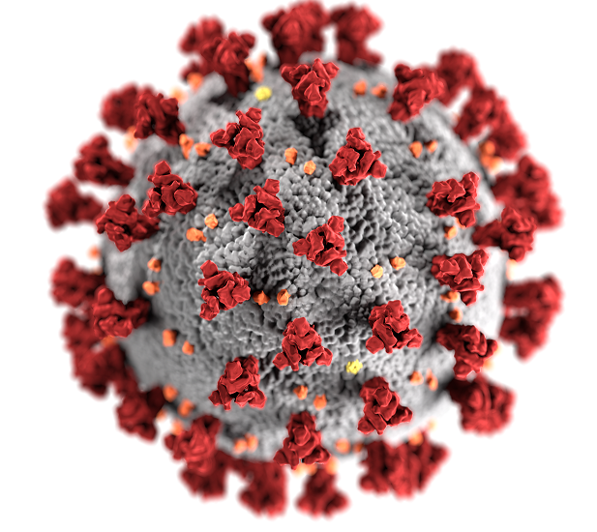
Understanding Coronavirus Variants
Dr. Trace Jordan
New York University

Slide 2
Outline
Coronavirus structure and genome
What are coronavirus variants?
How do coronavirus variants arise?
Examples of coronavirus variants
What can we do about coronavirus variants?

Slide 3
Coronavirus Structure and Genome

Slide 4
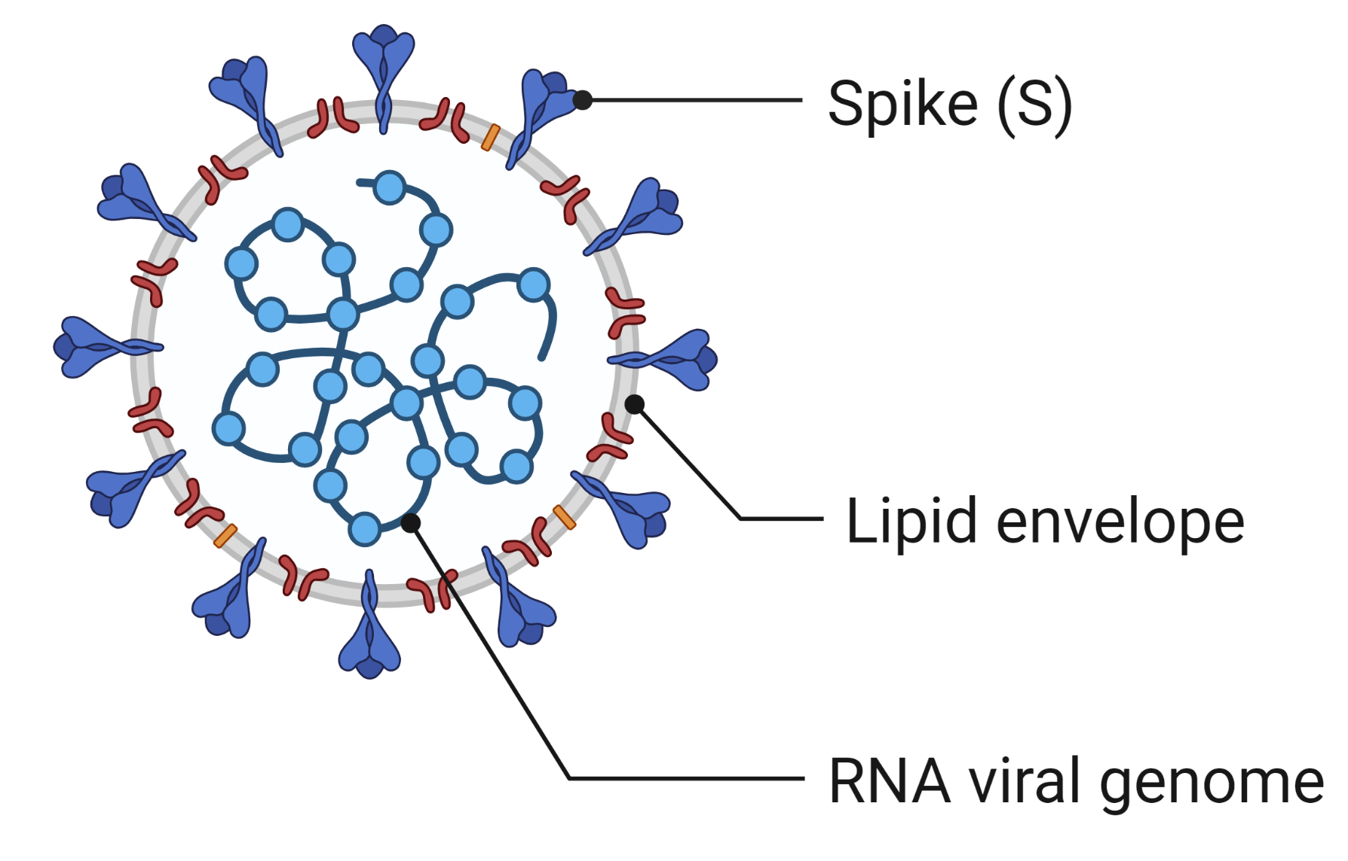
Viral Structure of SARS-CoV-2
COVID-19 is caused by a coronavirus called SARS-CoV-2.
Severe Acute Respiratory Syndrome Coronavirus-2
SARS-CoV-2 contains an RNA viral genome surrounded by a lipid envelope. Embedded in the envelope is a spike protein (S).

Slide 5
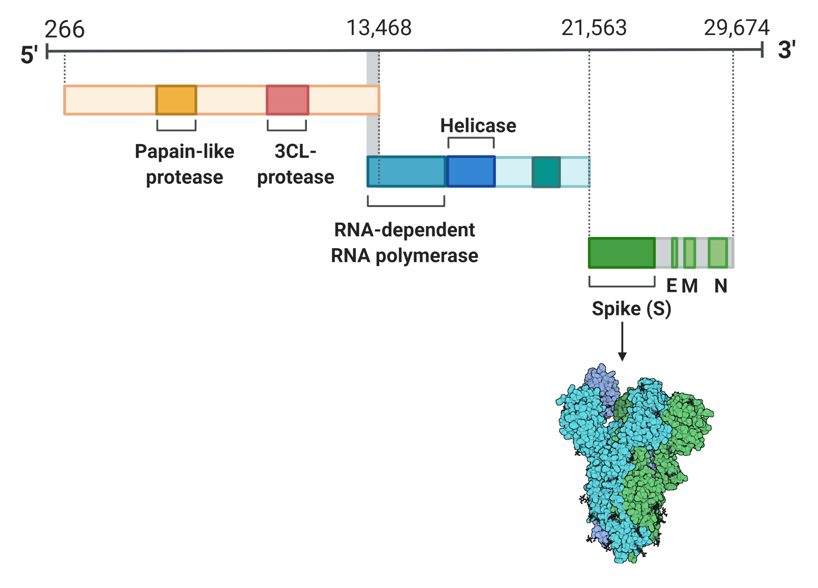
The RNA Genome Encodes Viral Proteins
The SARS-CoV-2 genome contains almost 30,000 RNA bases.
Sequences of RNA bases encode information to make 29 viral proteins.

Slide 6
What is a Coronavirus Variant?

Slide 7
Terminology for SARS-CoV-2 Variations
A mutation is a change in the RNA sequence of the viral genome or amino acid sequence of a viral protein.
A variant is a viral genome that differs in its RNA sequence.
A variant of concern is a viral variant that increases the spread and/or severity of COVID-19.
A strain is a variant with distinctive characteristics (e.g., it causes more severe disease symptoms).

Slide 8
Questions About SARS-CoV-2 Variants
Is the variant more transmissible?
Is the variant more virulent (i.e., are disease symptoms more severe)?
Can the variant escape the neutralizing effect of antibodies?
Does the variant reduce the effectiveness of vaccines?

Slide 9
How Do Coronavirus Variants Arise?

Slide 10
An RNA Mutation Can Change an Amino Acid
Original sequence: U C A → Ser (S)
Mutated sequence: G C A → Ala (A)
If the change happens at position 150 in the amino acid chain, it’s called an S150A mutation.

Slide 11
One-Letter Codes for Amino Acids
Alanine | A | Leucine | L
Arginine | R | Lysine | K
Asparagine | N | Methionine | M
Aspartic Acid | D | Phenylalanine | F
Cysteine | C | Proline | P
Glutamic Acid | E | Serine | S
Glutamine | Q | Threonine | T
Glycine | G | Tryptophan | W
Histidine | H | Tyrosine | Y
Isoleucine | I | Valine | V

Slide 12
Examples of Coronavirus Variants

Slide 13
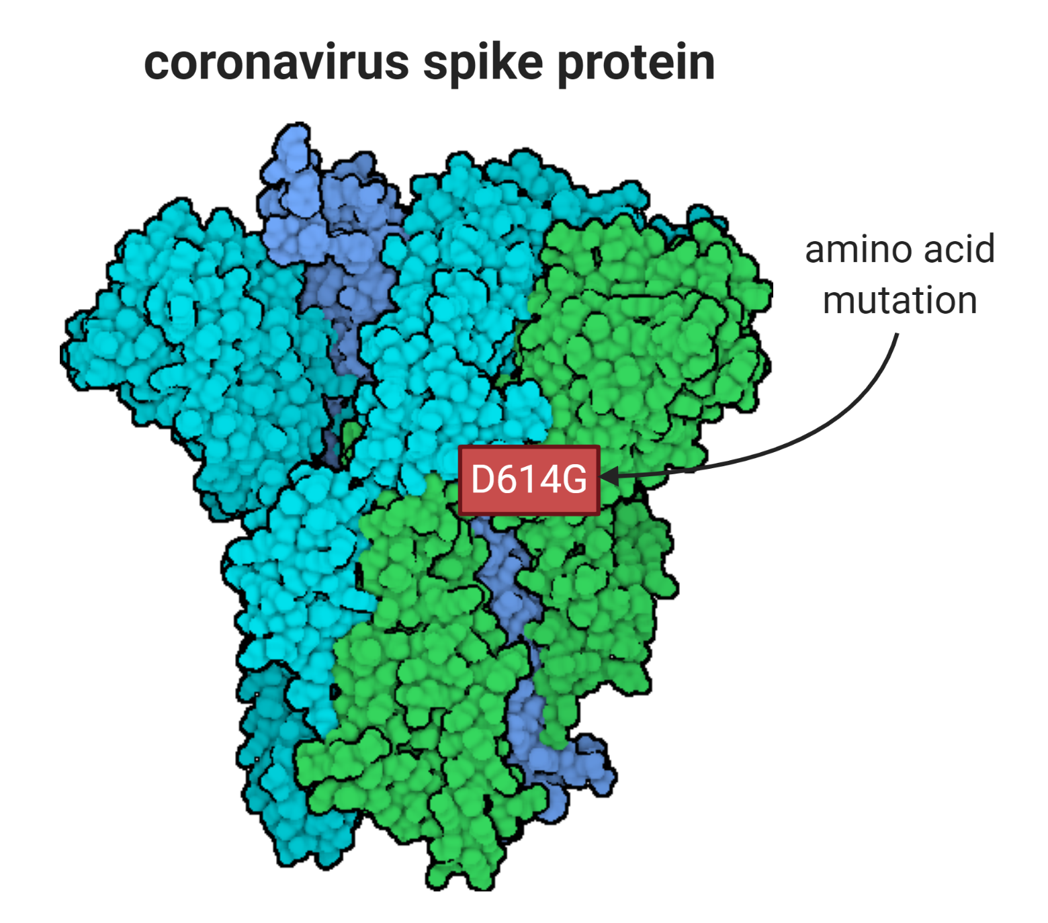
The D614G Variant of SARS-CoV-2
One variant of SARS-CoV-2 has a single amino acid mutation in position 614 of the spike protein.
The RNA codon for amino acid 614 has an A → G mutation.
G A U → Aspartic acid (D)
G G U → Glycine (G)
This variant is called D614G.

Slide 14
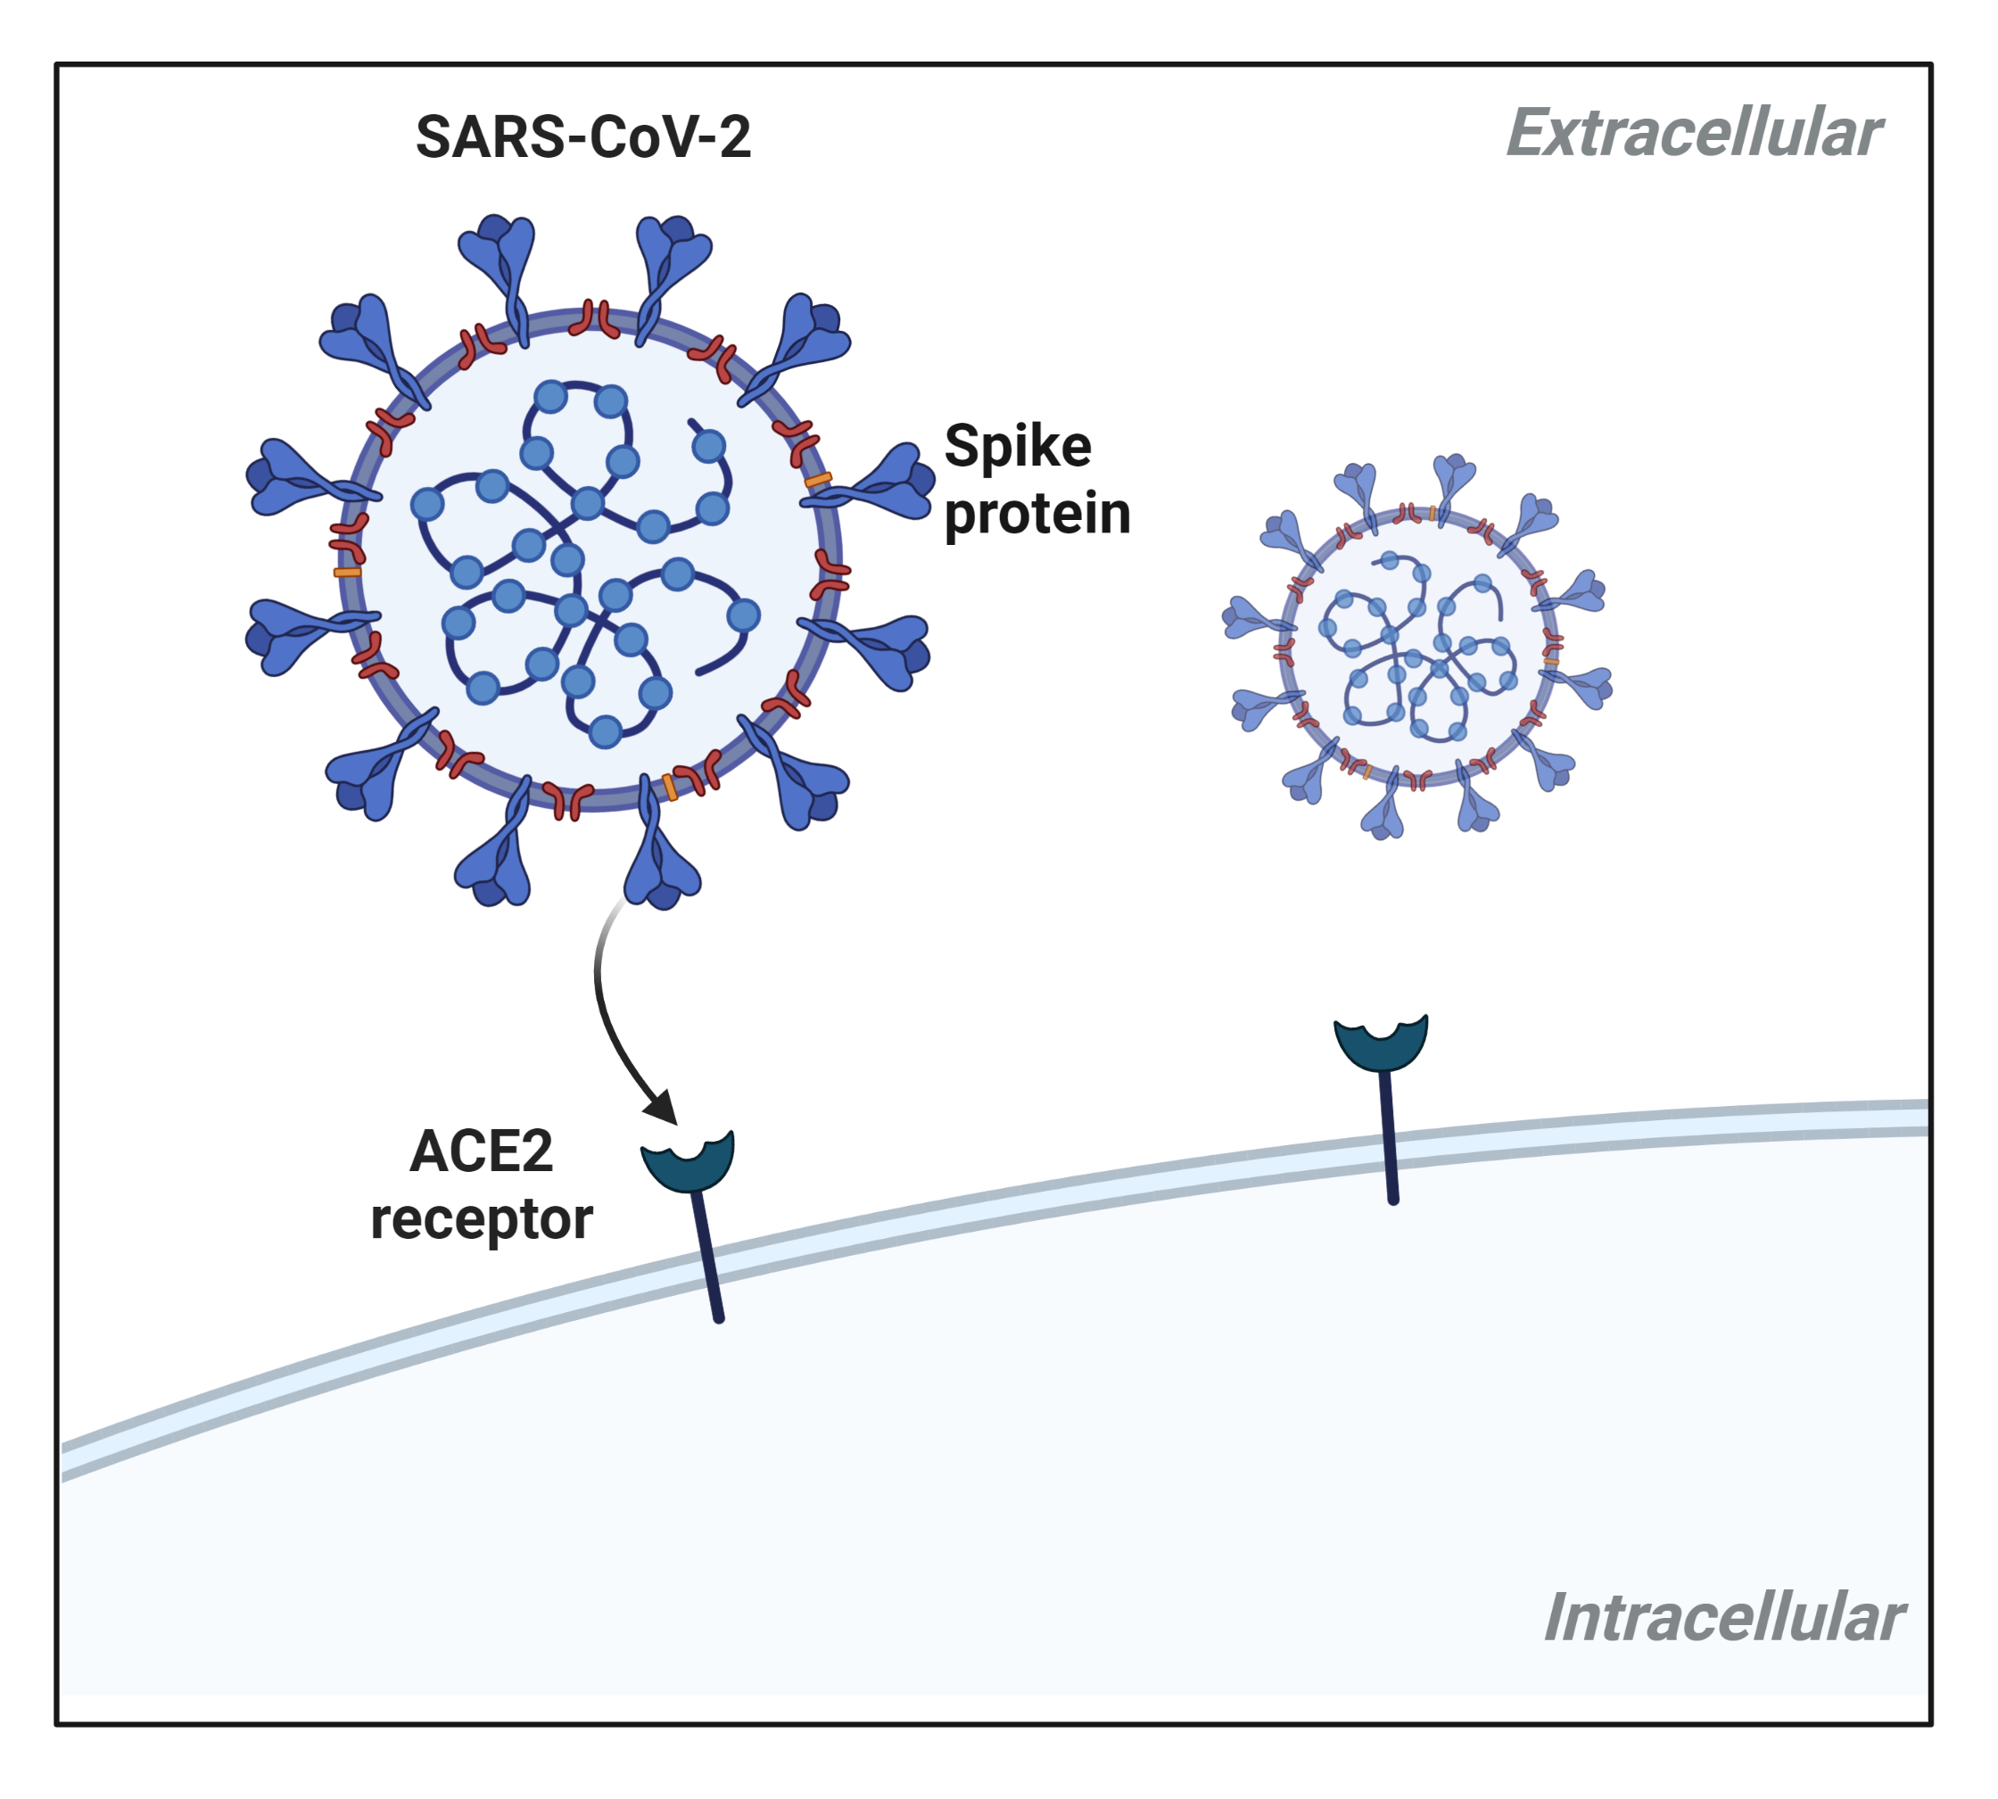
The D614G Variant Affects Receptor Binding
The D614G mutation causes a structural change in the spike protein from a “closed” to “open” structure.
The “open” structure of the spike has tighter binding to the ACE2 receptor.
The D614G variant has greater transmission and replication.

Slide 15
Classifying Variants of SARS-CoV-2
The World Health Organization (WHO) classifies variants using Greek letters.
The U.S. Centers for Disease Control (CDC) has identified four variants of concern (August 2021).
Alpha
Beta
Gamma
Delta

Slide 16
The Delta Variant of SARS-CoV-2
The delta variant is 2x transmissible as the original SARS-CoV-2.
The delta variant produces viral loads that are approximately 1,000x compared to other variants.
The delta variant now accounts for over 90% of of new COVID-19 cases in the U.S. (July 2021).
The dominance of the delta variant is an example of evolution by natural selection.
The Delta variant has a reproductive advantage compared to other coronavirus variants.

Slide 17
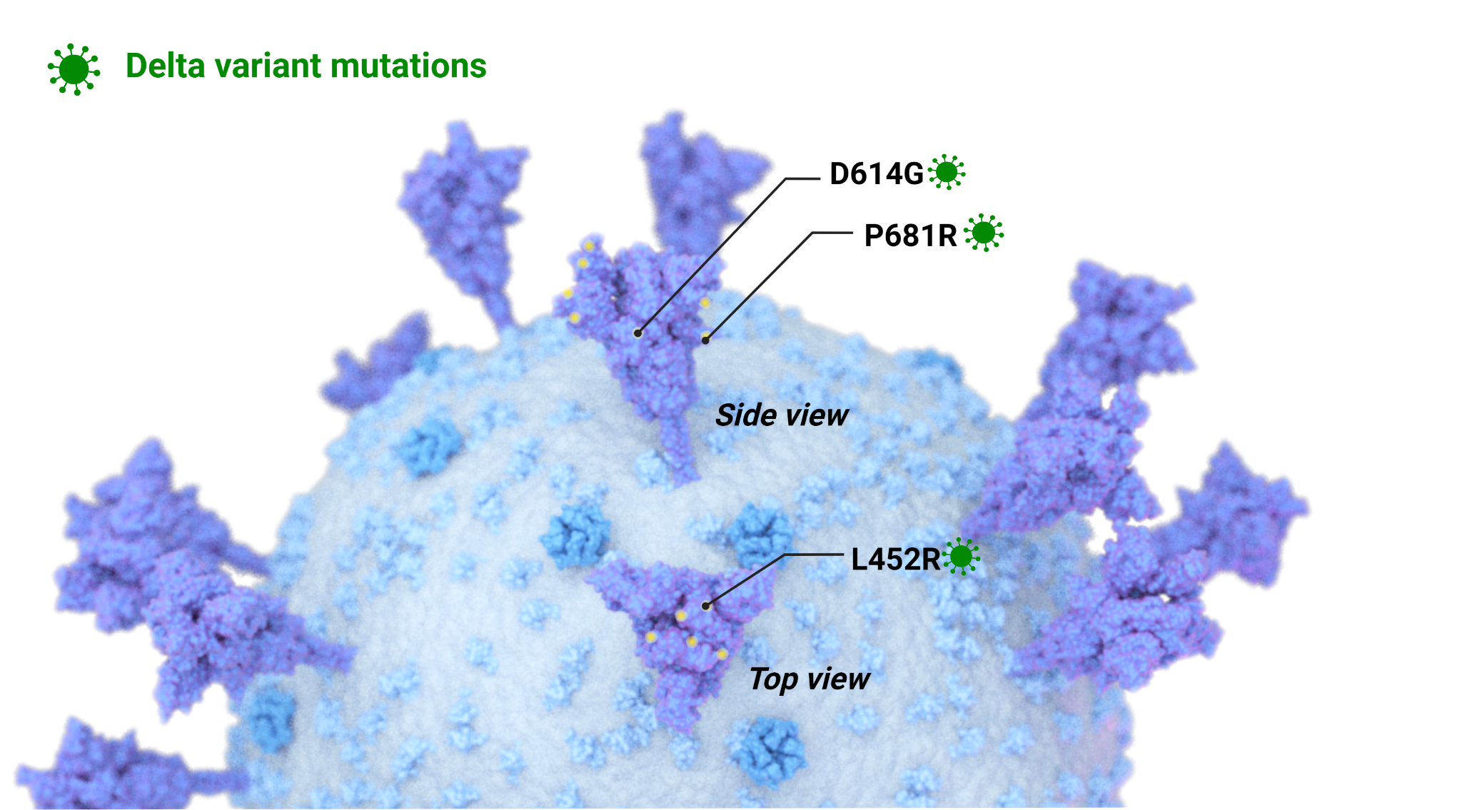
Spike Protein Mutations in the Delta Variant

Slide 18
Vaccines Still Work Against the Delta Variant
A study in the U.K. examined the effectiveness of vaccines in preventing disease symptoms from the Alpha and Delta variants.
Two doses of the Pfizer/BioNTech vaccine were 88% effective against the Delta variant compared to 94% for the Alpha variant.
But one dose of the vaccine was only 31% effective compared to 49% for the Alpha variant.
These data demonstrate the importance of being fully vaccinated.

Slide 19
What Can We Do About Coronavirus Variants?

Slide 20
Taking Action Against Coronavirus Variants
Viruses will always mutate and evolve...that’s what viruses do!
We can reduce the origin and spread of new coronavirus variants by reducing opportunities for SARS-CoV-2 to replicate.
Wearing a mask, practicing social distancing, and washing your hands reduces the transmission of the virus.
Getting fully vaccinated makes it less likely that you will transmit the virus to other people.
We can ALL make a difference in taking action against SARS-CoV-2 variants!

Slide 21
Sources
All scientific illustrations were created by the author using BioRender.

Slide 22
