Slide 1

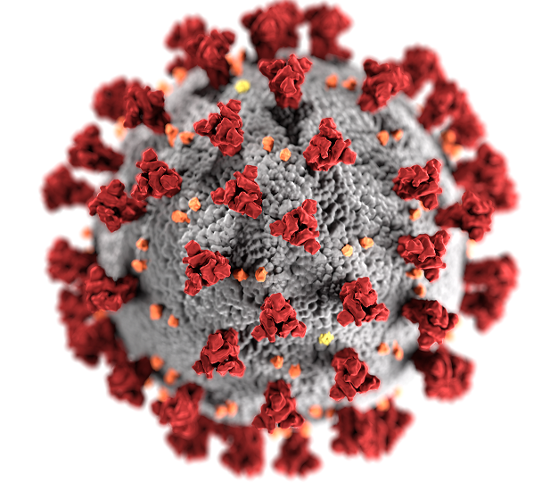
Understanding the Virus That Causes COVID-19
Dr. Trace Jordan
New York University

Slide 2

Outline
Getting the results of a COVID-19 test.
What is a coronavirus?
What is the structure of a coronavirus?
How does a coronavirus infect cells?
How does a COVID-19 test work?
Revisiting the results of a COVID-19 test.

Slide 3
Getting the Results of
a COVID-19 Test

Slide 4
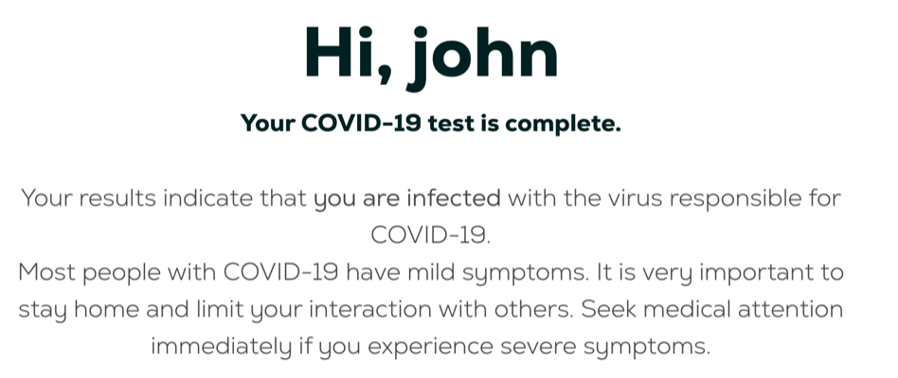
Getting the Results of a COVID-19 Test

Slide 5
What Is a Coronavirus?

Slide 6
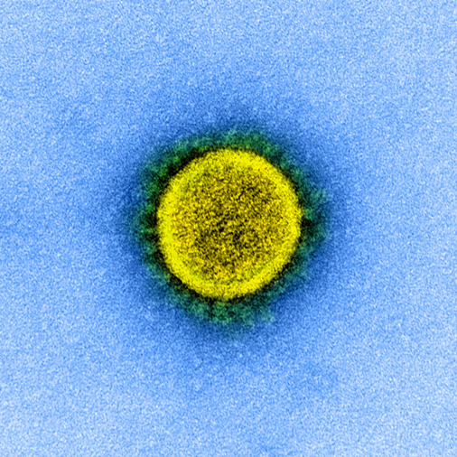
A Coronavirus Is Named for Its Appearance
A coronavirus is named for its appearance when viewed with an electron microscope.
The term “corona” means “crown.”
Think of a “coronation” of a king or queen.
A coronavirus has “spikes” protruding from its surface that makes it look like a crown.

Slide 7
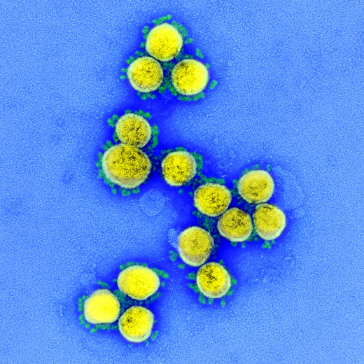
Coronaviruses Cause Respiratory Diseases
SARS
Severe Acute Respiratory Syndrome (2002)
MERS
Middle East Respiratory Syndrome (2012)
COVID-19
Coronavirus Disease (2019)

Slide 8
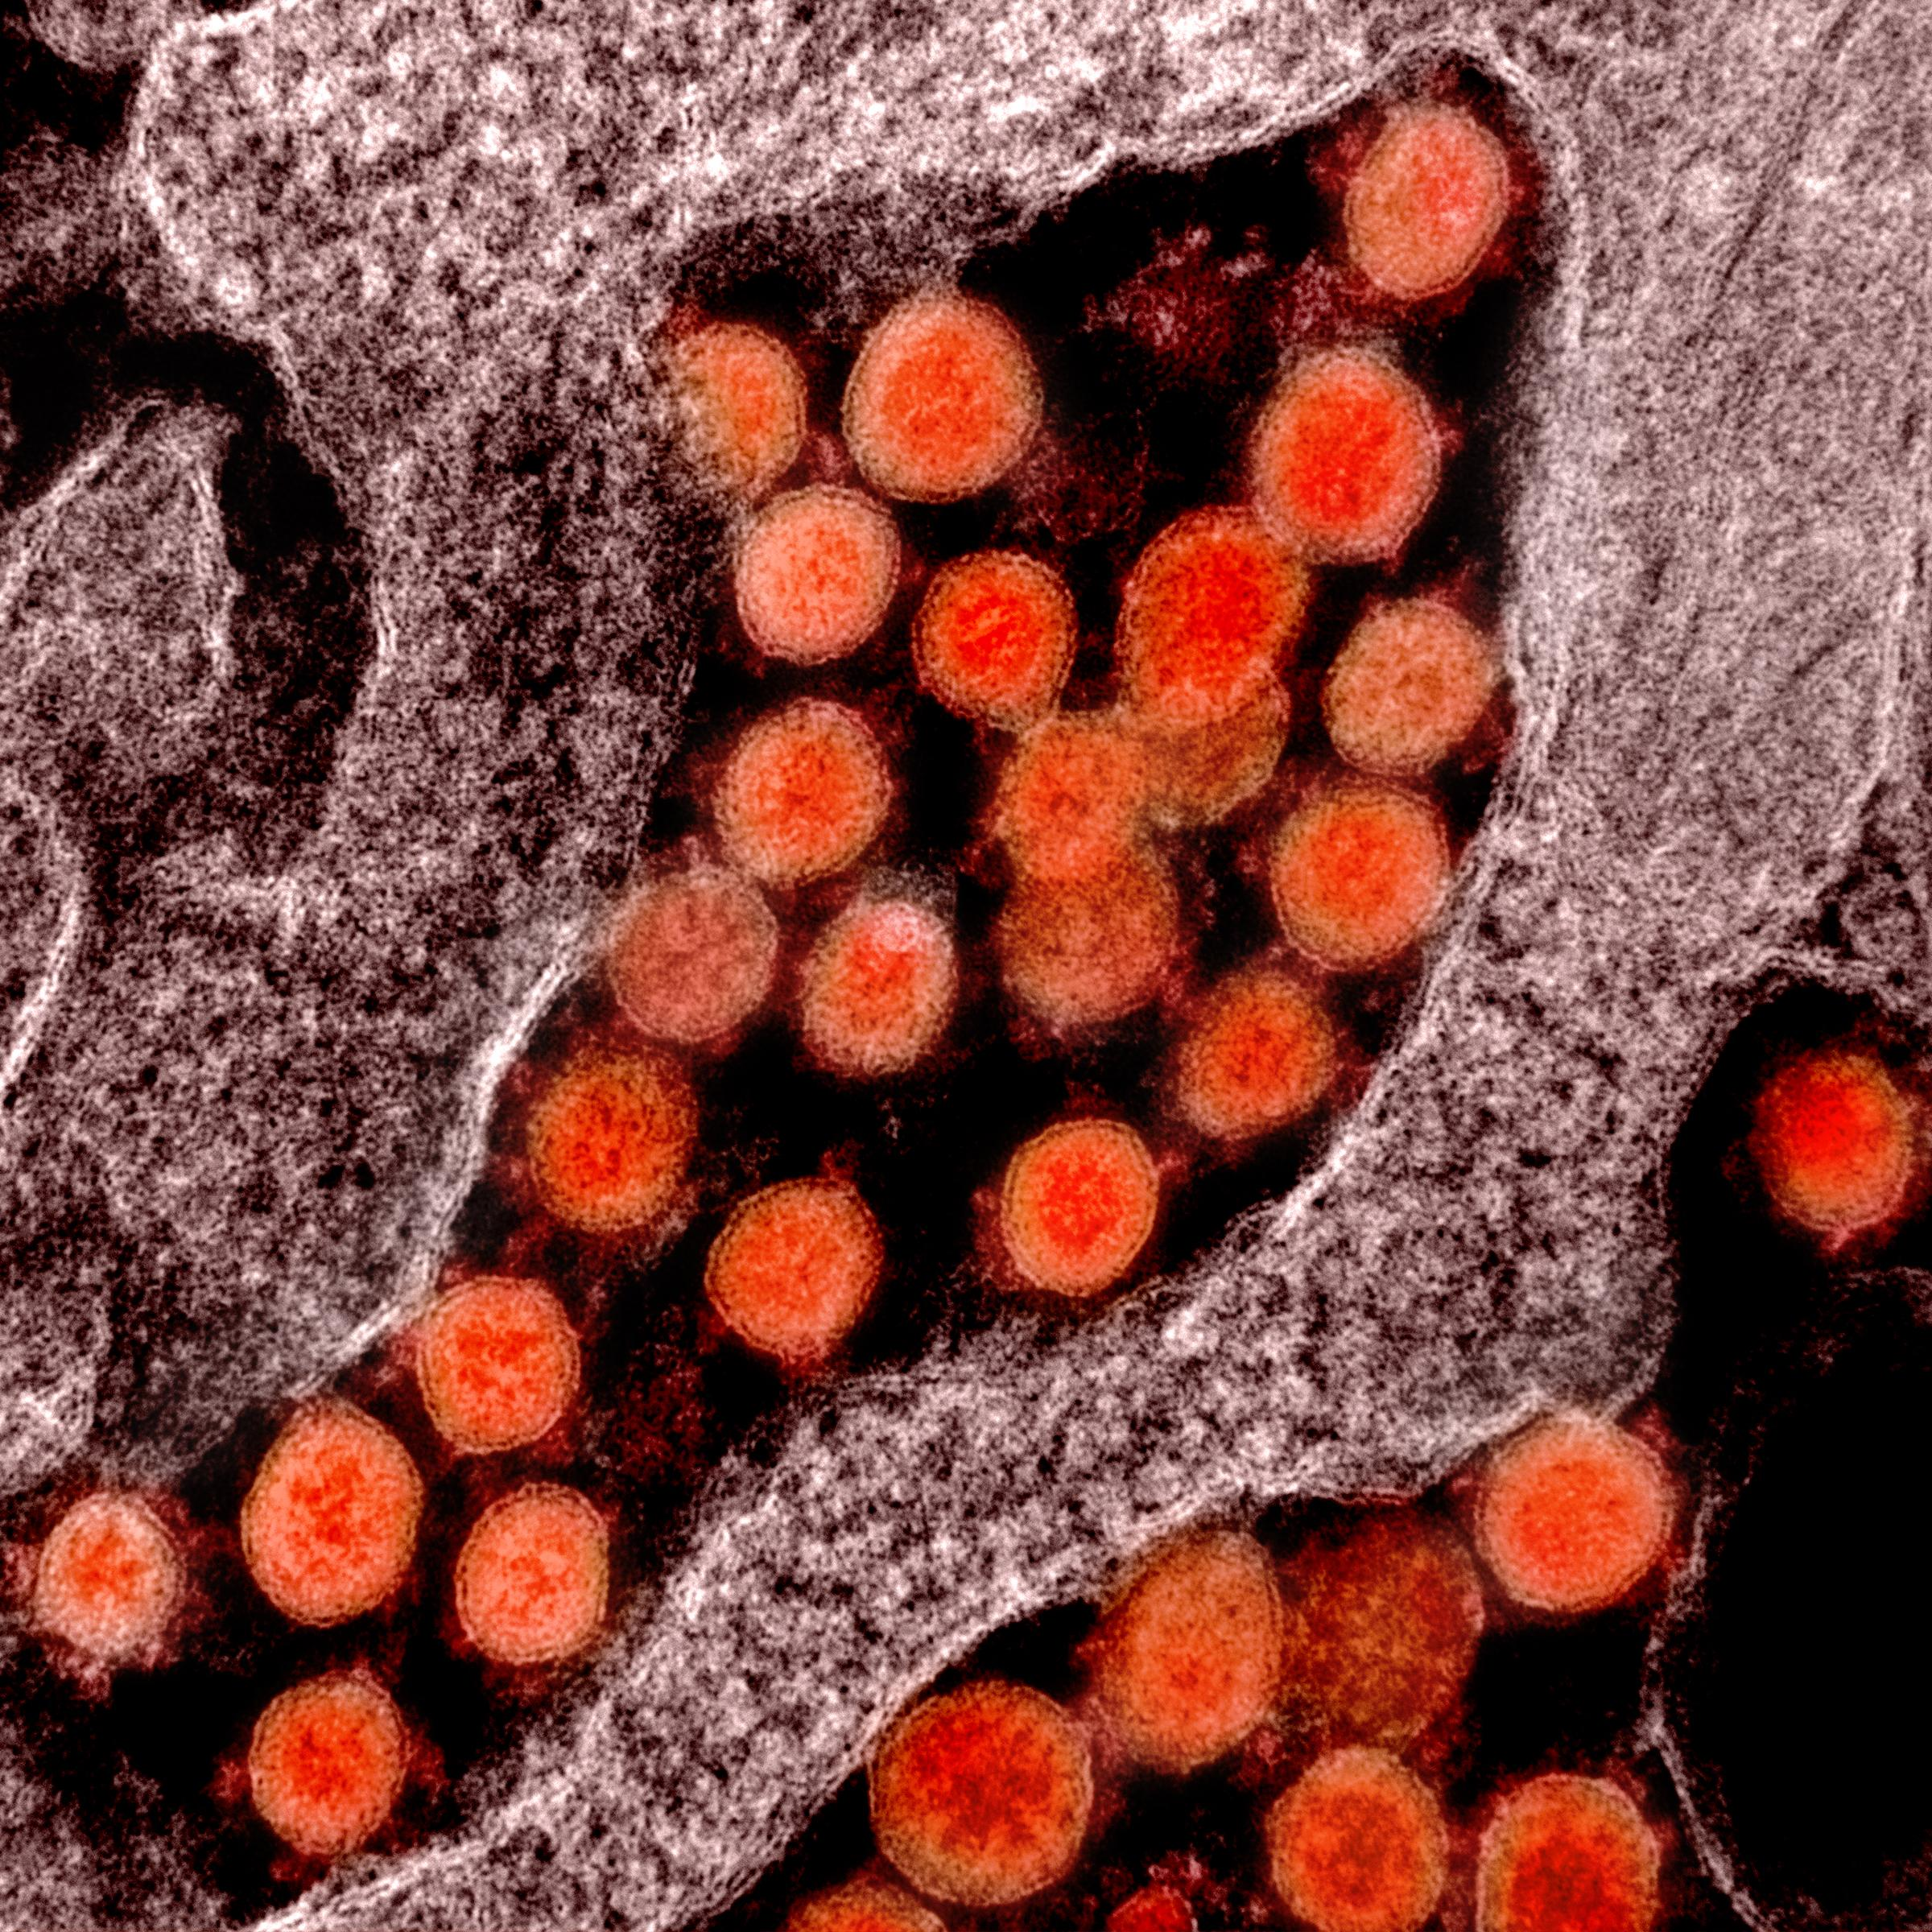
COVID-19 Is Caused by SARS-CoV-2
COVID-19 is a disease – i.e., a set of medical symptoms.
A microorganism that causes a disease is called a pathogen.
The pathogen that causes COVID-19 is a virus called SARS-CoV-2.
Severe Acute Respiratory Syndrome Coronavirus-2

Slide 9
What Is the Structure
of a Coronavirus?

Slide 10
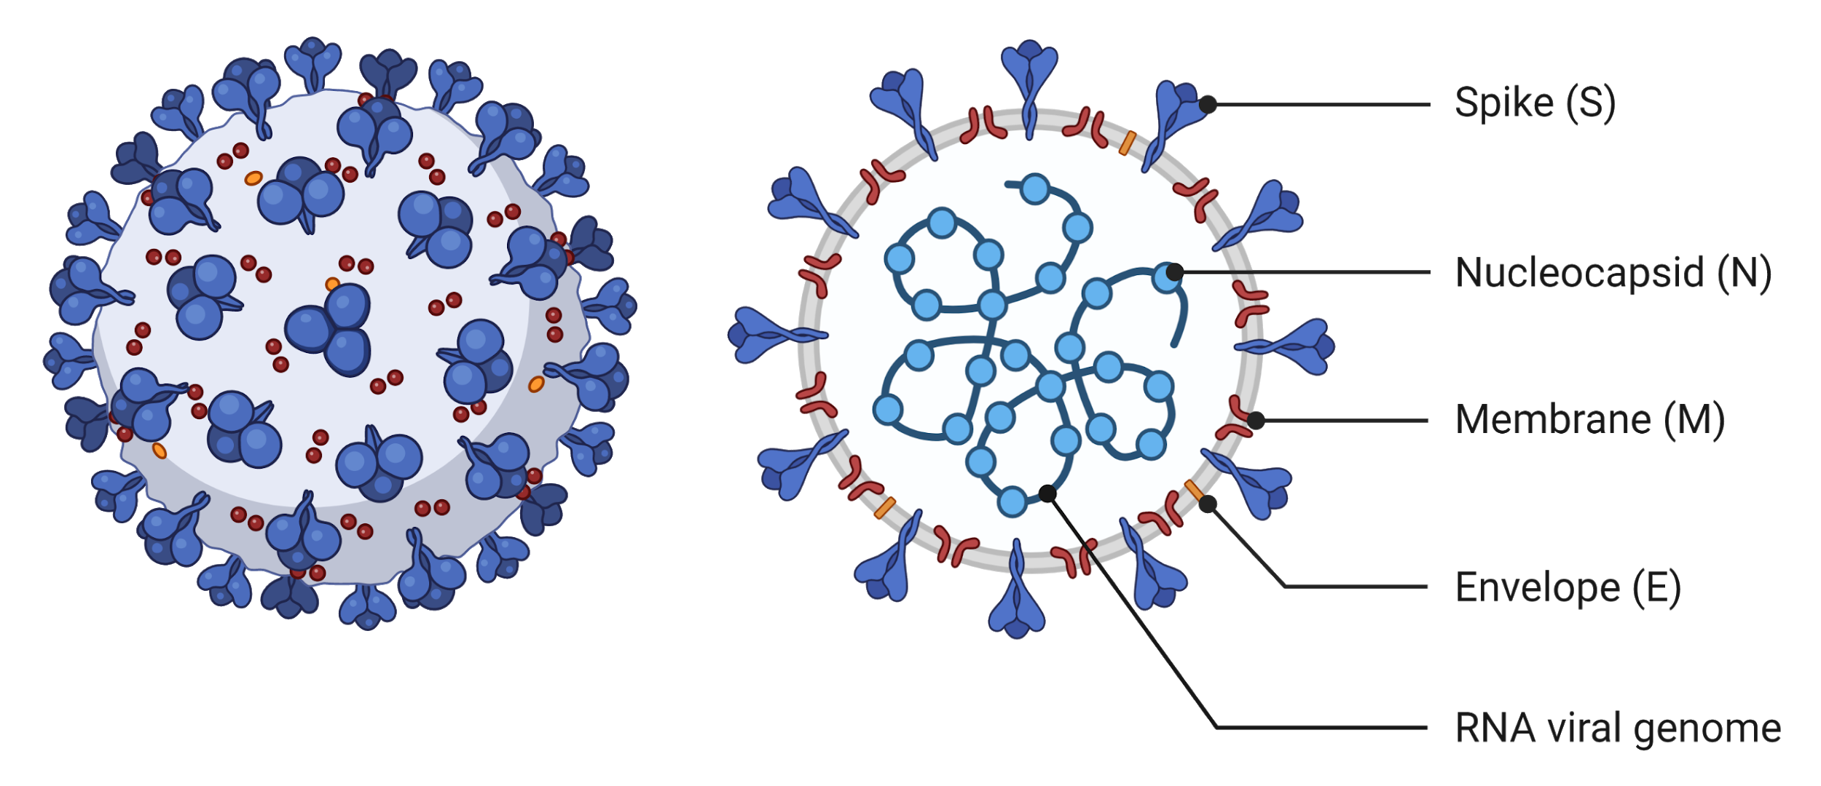
SARS-CoV-2 Is an Enveloped Virus

Slide 11
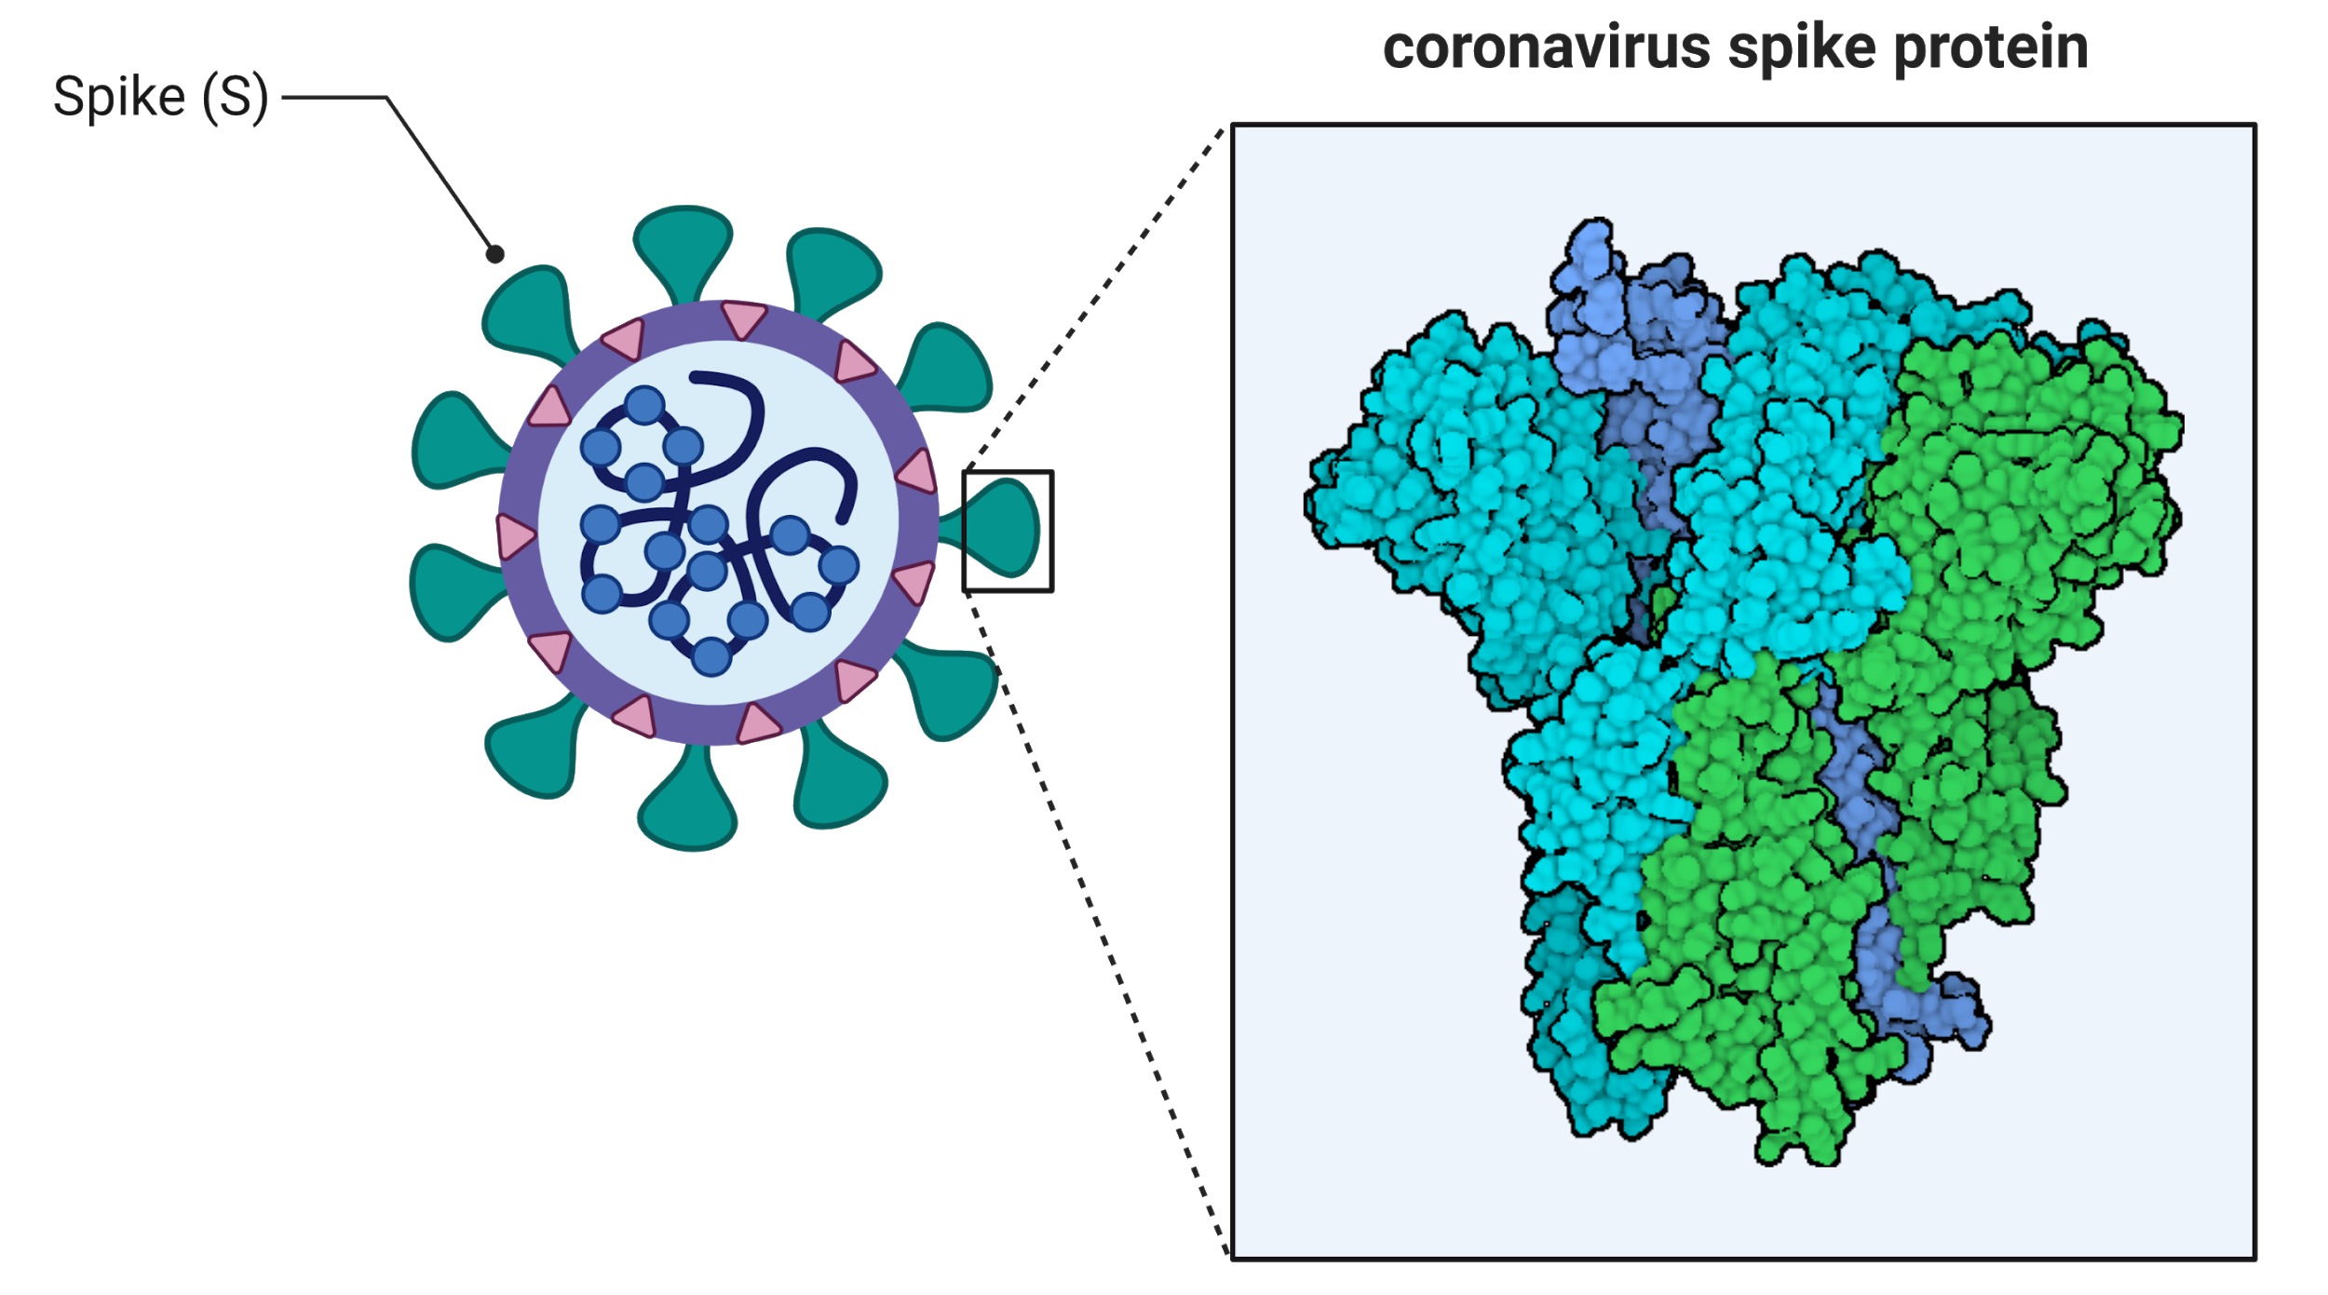
SARS-CoV-2 Has a Prominent Spike Protein
The virus uses its spike protein to attach to human cells.
The spike protein also generates a human immune response.

Slide 12
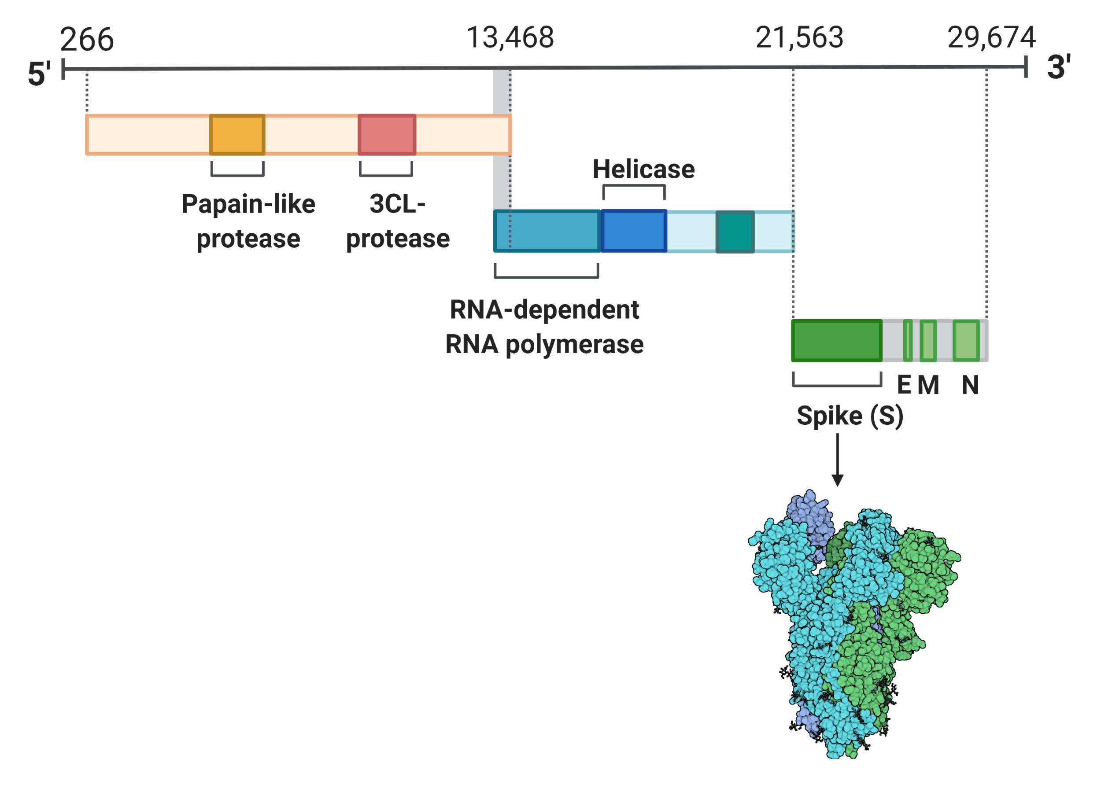
SARS-CoV-2 Contains an RNA Genome
The SARS-CoV-2 genome contains almost 30,000 RNA bases.
Sequences of RNA bases encode information to make viral proteins.

Slide 13
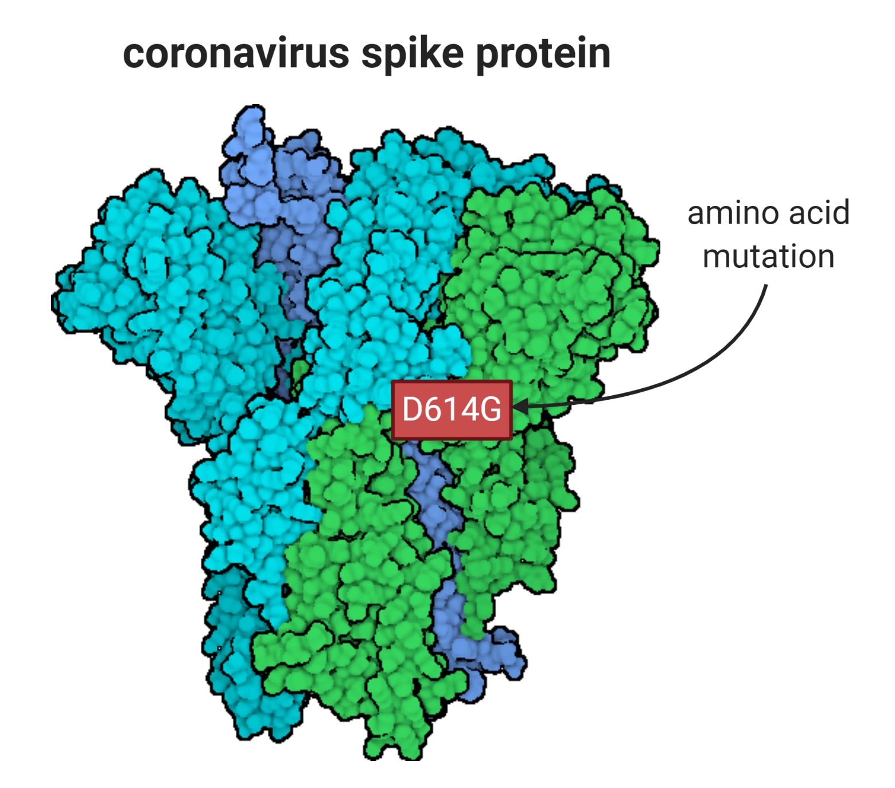
SARS-CoV-2 Mutates and Evolves
Mutations cause changes in the RNA genome of SARS-CoV-2.
One SARS-CoV-2 variant has a single amino acid change in the spike protein (D614G).
Viral variants are subject to evolution by natural selection.

Slide 14
How Does a Coronavirus Infect Cells?

Slide 15
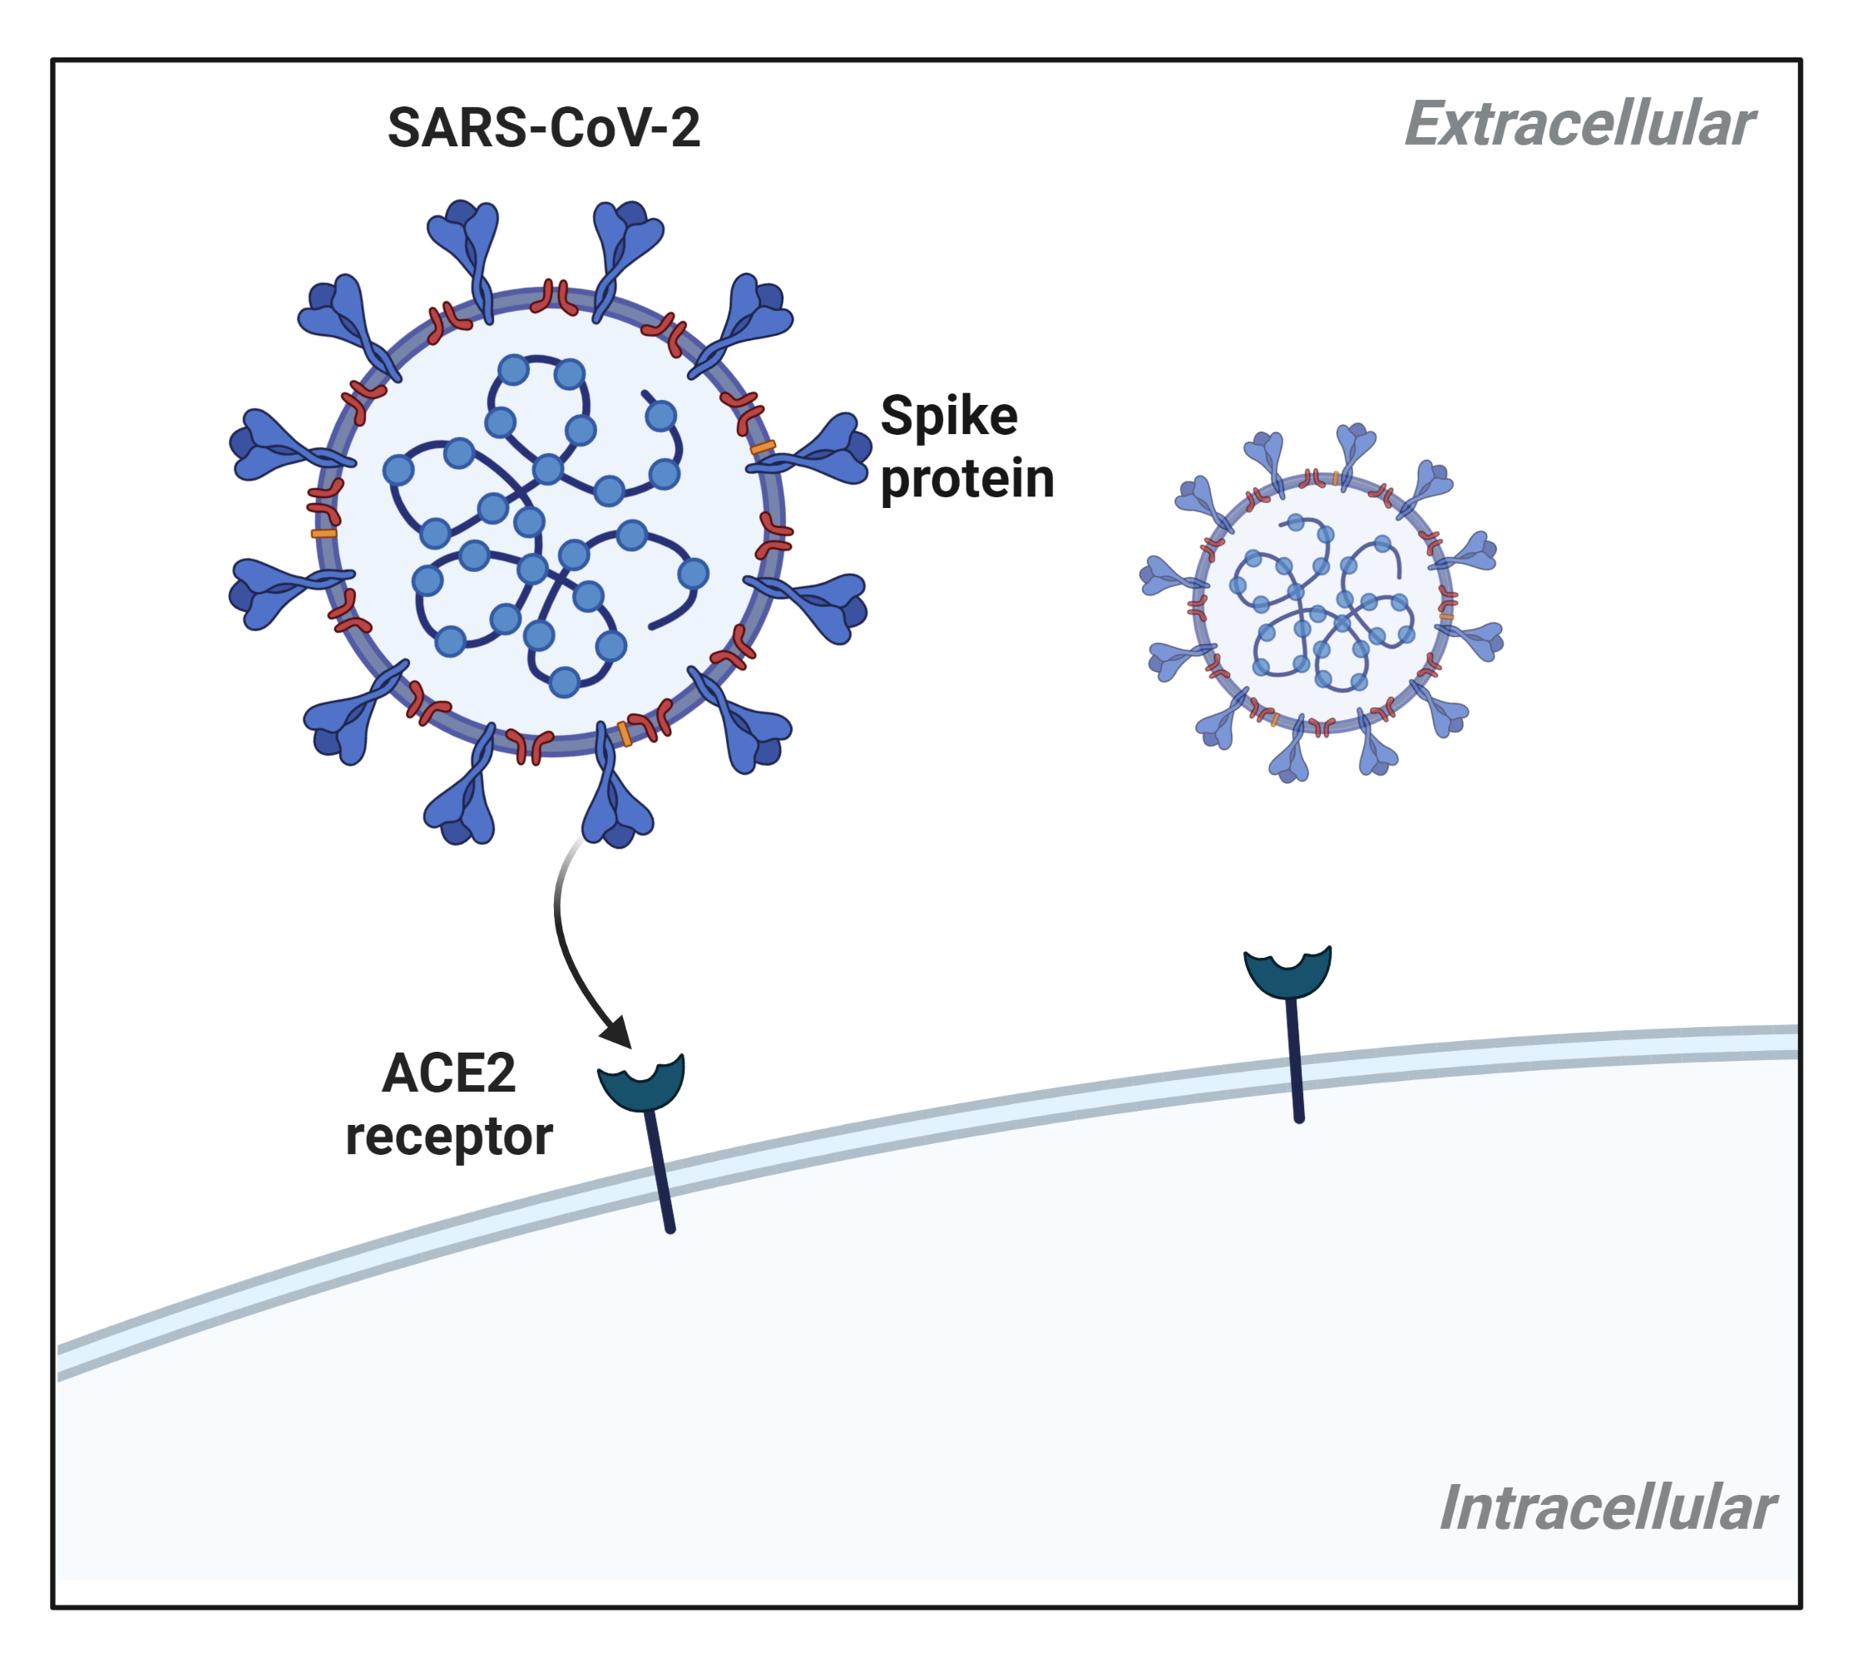
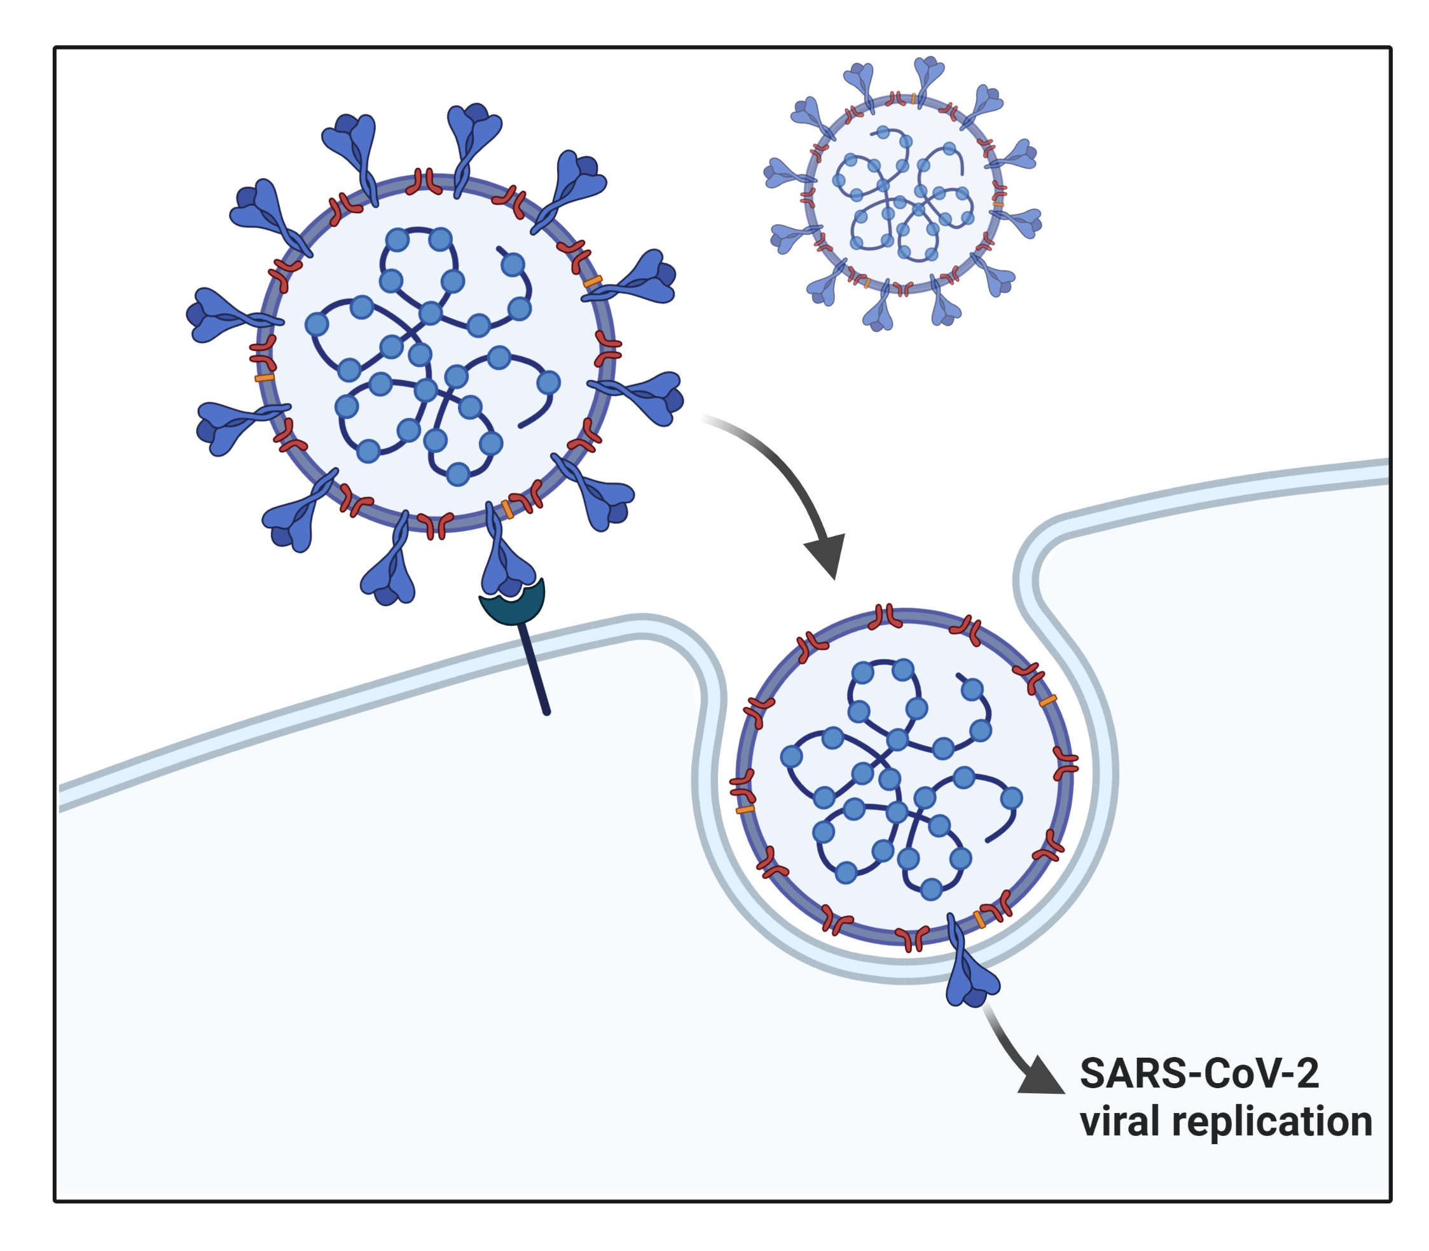
SARS-CoV-2 Binds to the ACE2 Receptor
ACE2 Angiotensin-converting enzyme 2

Slide 16
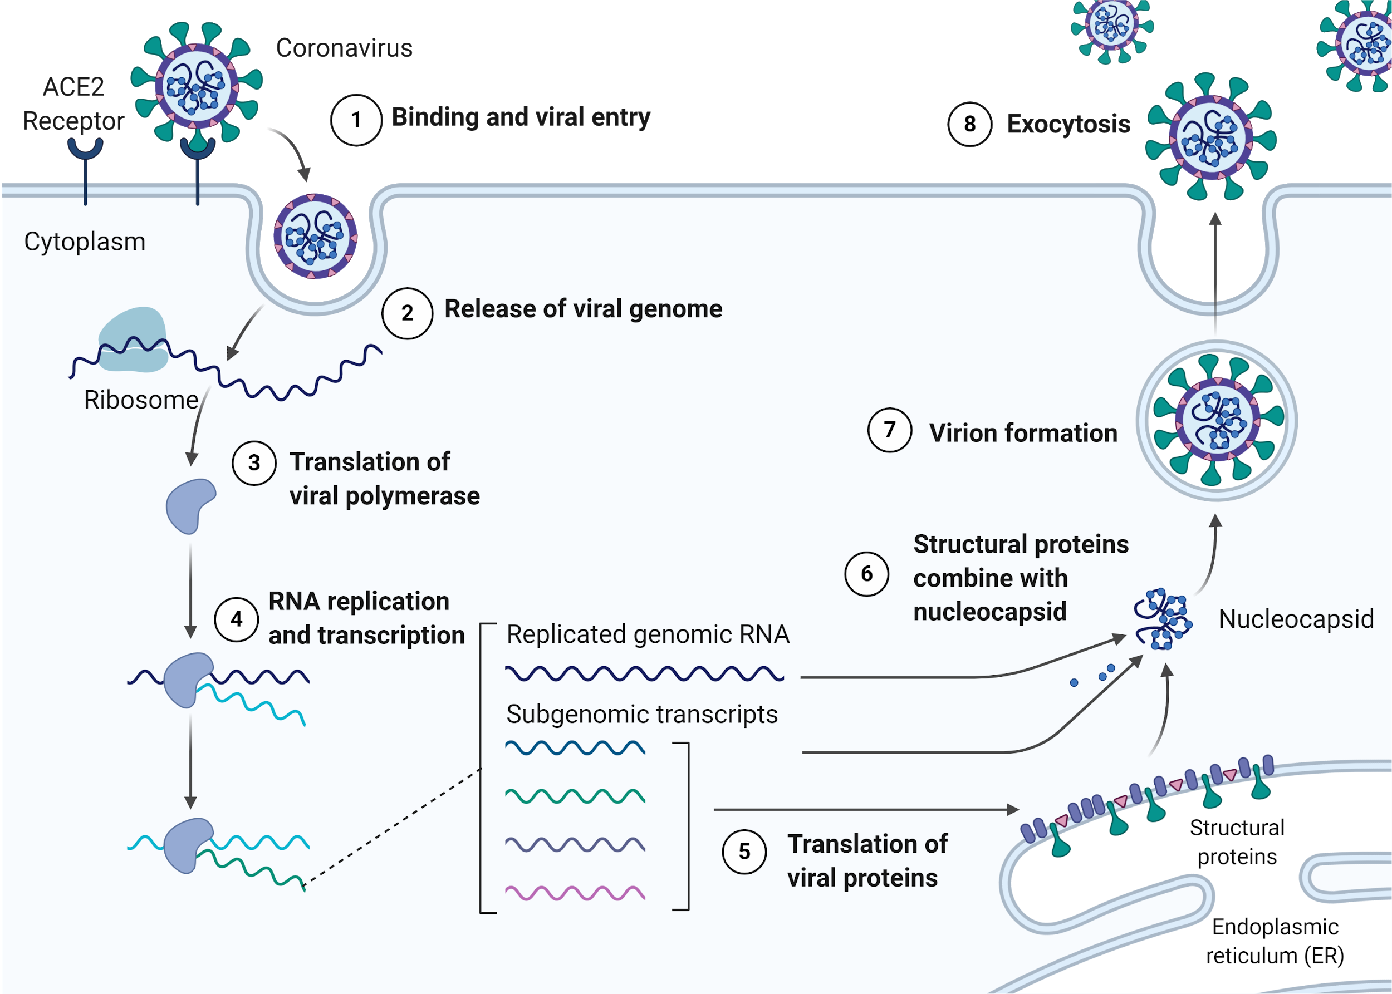
SARS-CoV-2 Replicates Within a Host Cell

Slide 17
How Does a COVID-19 Test Work?

Slide 18
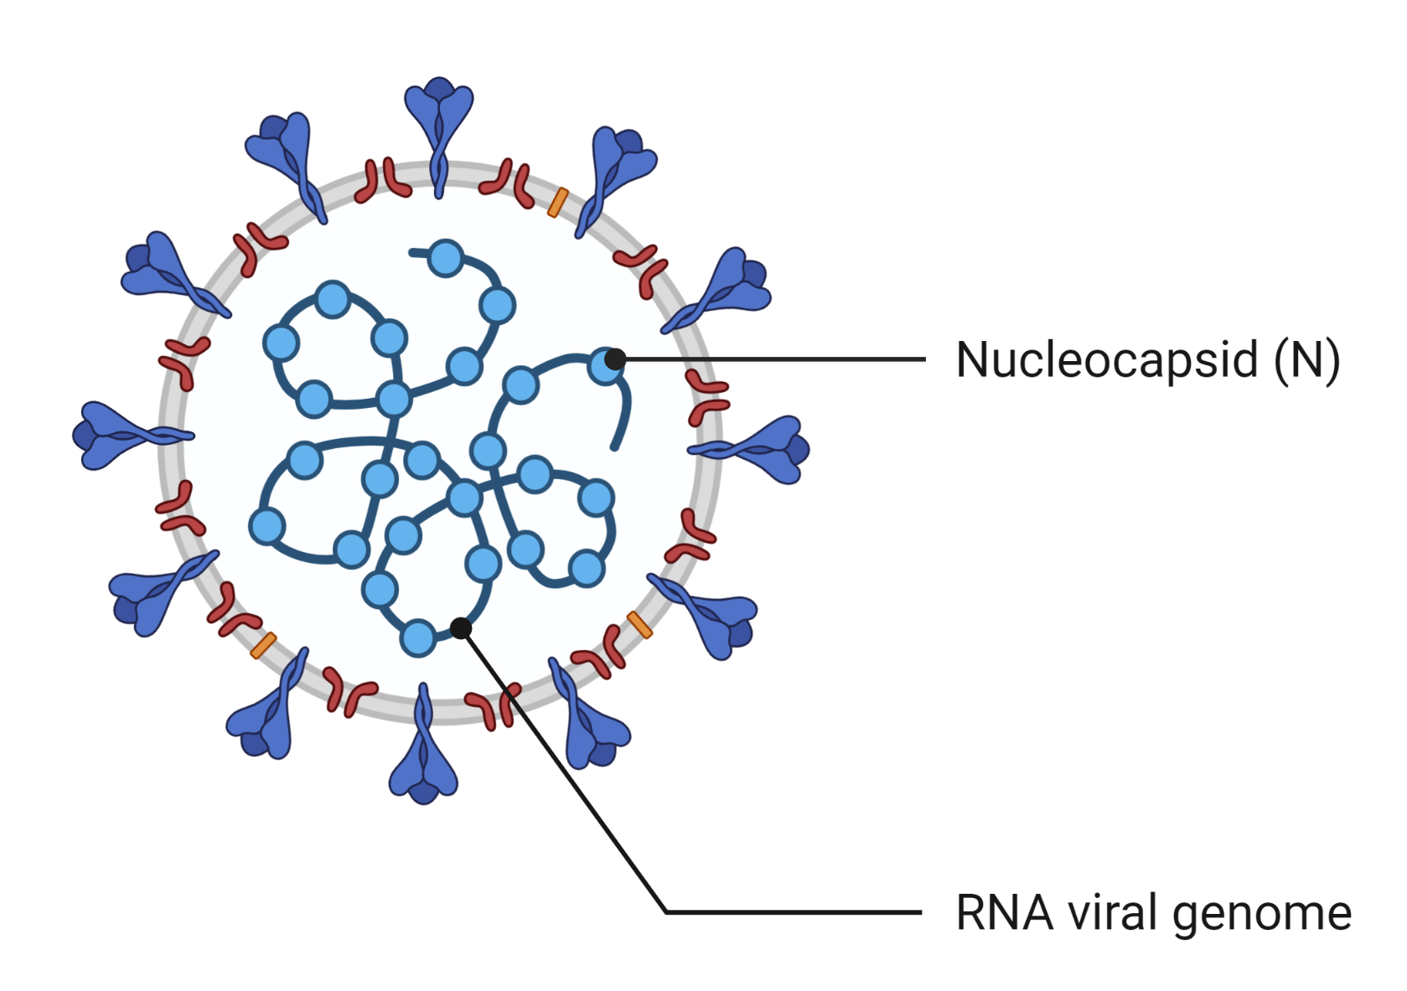
A COVID-19 Test Detects Viral Components
A diagnostic test for an active SARS-CoV-2 infection detects components of the virus.
A PCR test detects regions of the RNA viral genome.
PCR = Polymerase Chain Reaction
A antigen test detects viral proteins (e.g., nucleocapsid, N).
antigen = antibody generating

Slide 19
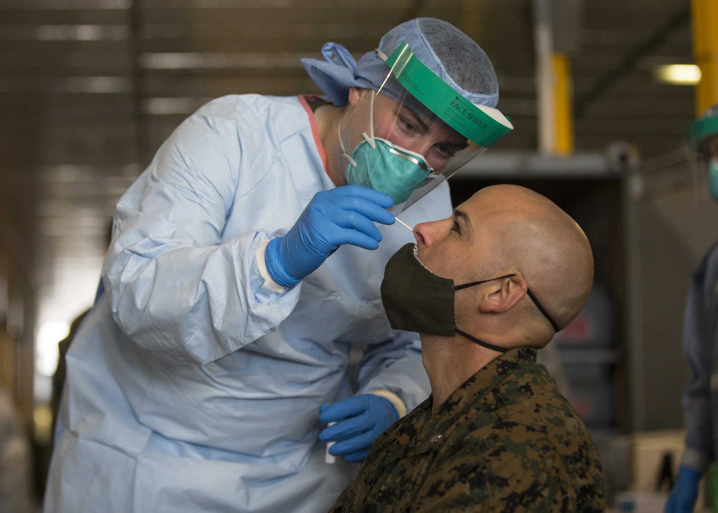
A PCR Test

Slide 20
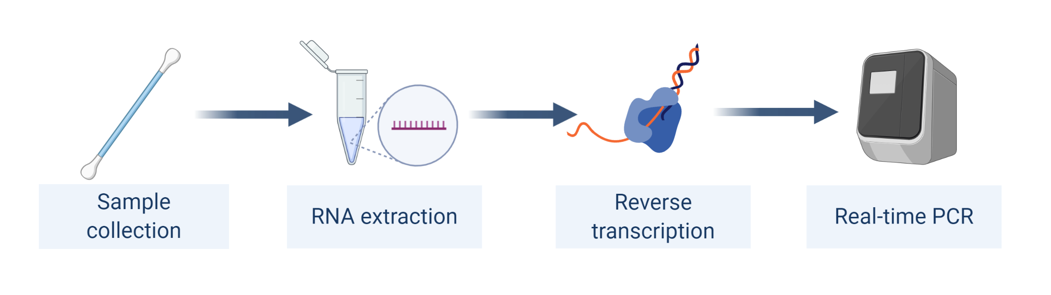
A PCR Test Detects Regions of Viral RNA
PCR is a technique that amplifies the quantity of DNA.
The viral genome of SARS-CoV-2 is composed of RNA.
Viral RNA is converted to viral DNA using reverse transcription.

Slide 21
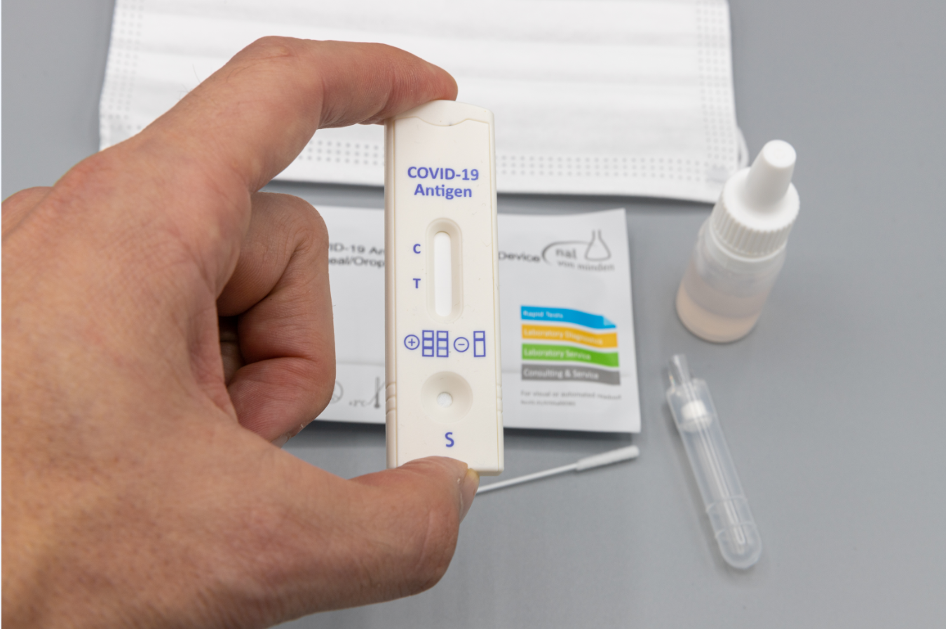
An Antigen Test

Slide 22
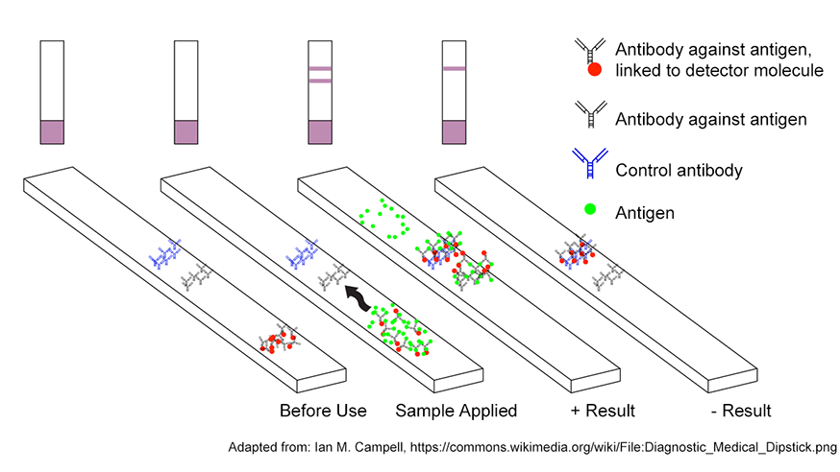
An Antigen Test Detects Viral Protein

Slide 23
Are There Other Types
of COVID-19 Tests?

Slide 24
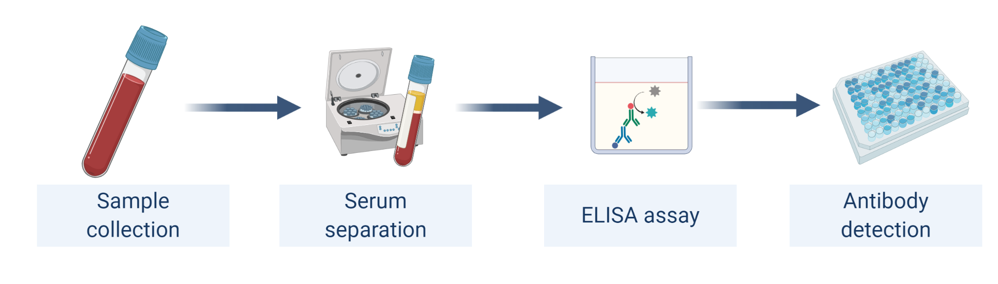
An Antibody Test Detects Human Antibodies
Infection with SARS-CoV-2 generates an immune system response.
An antibody test detects the presence of human antibodies.
Antibody production has a time lag and persists after infection.
This test is also called a serology test (it uses blood serum).

Slide 25
Revisiting the Results of the COVID-19 Test

Slide 26
Getting the Results of a COVID-19 Test

Slide 27
Sources
All scientific illustrations of coronavirus structure and replication were created by the author using BioRender.
Slide 19: Photo of a PCR test for COVID-19
Wikimedia Commons
NavyMedicine https://www.flickr.com/photos/61270229@N05/50275876867
Slide 21: Photo of an antigen test for COVID-19
Wikimedia Commons
Dronepicr https://www.flickr.com/photos/132646954@N02/50687303958
Slide 22: Diagram of an antigen test for COVID-19
American Society for Microbiology https://asm.org/Articles/2020/April/COVID-19-Testing-FAQs

Slide 28


